Slide 1


Vision and Values Work Programme – for Branch Workshops
March/April 2025

Slide 2
Great organisations are built on strong Backbones
OUR VISION = WHERE WE WANT TO GET TO – OUR AMBITIOUS FUTURE
OUR STRATEGY = HOW WILL WE ACHIEVE OUR VISION
OUR LEADERSHIP PHILOSOPHY – WHAT WE EXPECT
OUR PURPOSE = WHY WE EXIST
OUR VALUES = WHAT WE STAND FOR
OUR BRAND = OUR REPUTATION WITH OUR CUSTOMERS
OUR STORY = AN INSPIRING WAY OF TELLING OUR HISTORY

Slide 3
Currently we have
Vision: Improving the Quality and Performance of the Built Environment
Mission: Supporting the professionalism of our membership through:
Effective Leadership
Quality Education
Compliance with Legislation
Creation of Industry Partnerships
Relevant Products and Services

Slide 4
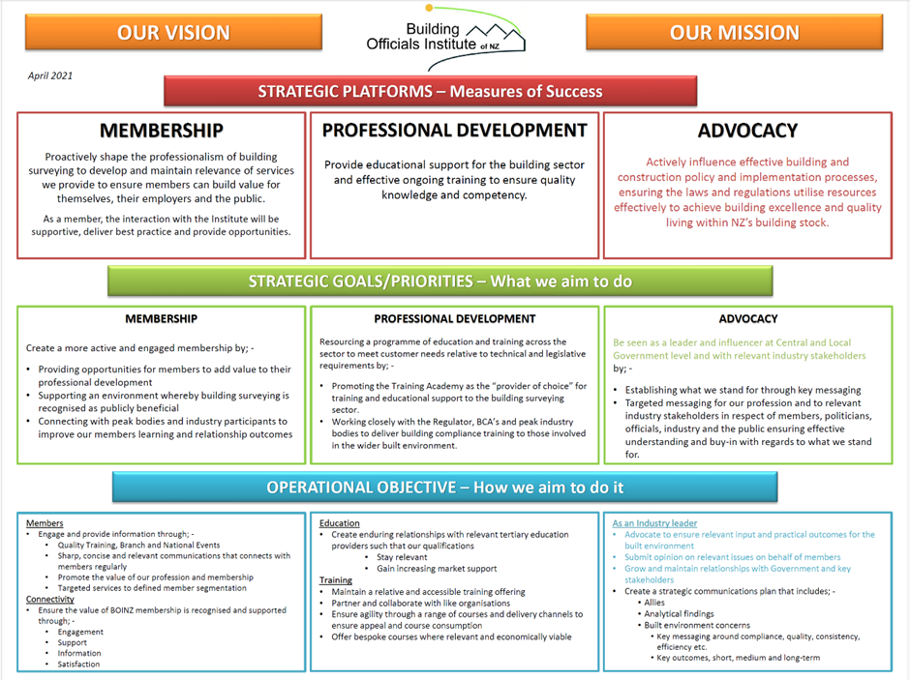

Slide 5
Refreshing our Vision
What is our ultimate goal?
What values are important?
What is our unique value proposition?
Who are our stakeholders?
Where do we see BOINZ in 5, 10, 15 years
What challenges do we want to address?
How do we/will we define success?
What kind of legacy do we want to leave?
What are our aspirations for innovation and growth?
What does an ideal BOINZ future look like?
Is our Vision concise, positively impactful, and aspirational?

Slide 6
Refreshing our Value Proposition
Questions for Branch Members:
What does building control/surveying mean to you?
What are the different personas of potential BOINZ members?
Why would each of the different persona types want to join BOINZ?
What member services does BOINZ currently offer? List the benefits attached to each service.
Is there a gap between the above points 3 & 4?

Slide 7
Vision and Values – The Programme Process
Board members own the Strategic Review process
Introduce programme to Branch Chairs and Secretaries on 19 February 2025
Board members to run workshops at local Branch meetings during March/April of 2025 to test:
  What about BOINZ is important to members?
  What values do members consider are important for BOINZ and the Board?
  What are members’ aspirations for BOINZ in terms of support, advocacy, innovation and growth?
  What metrics should be used by members to define whether or not BOINZ is perceived to be successful?
  What will an ideal future BOINZ look like in 5, 10, 15 years?

Slide 8
Thank you for your time and input!

