Slide 1
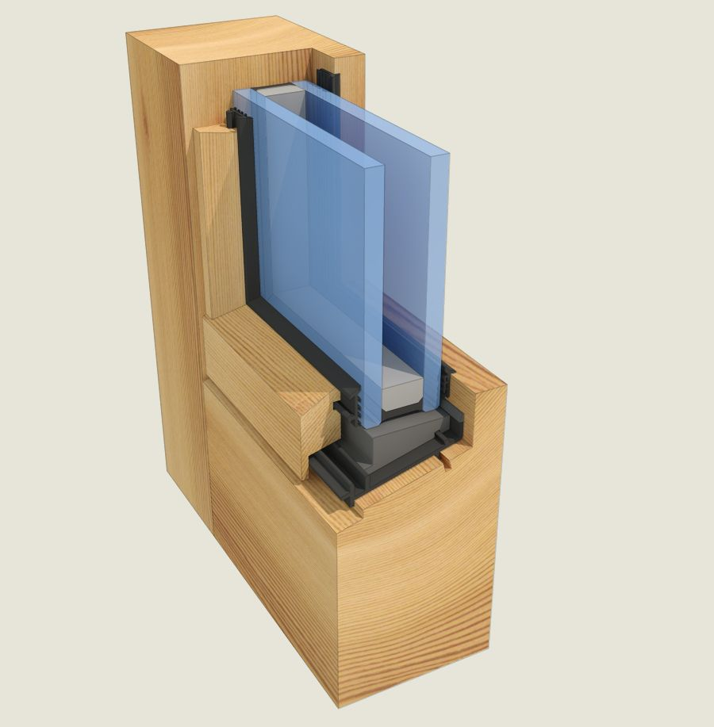

Thermawood Australasia Southern BOINZ Branch Meeting

