Slide 1

Insurance Discussion for BOINZ

Slide 2
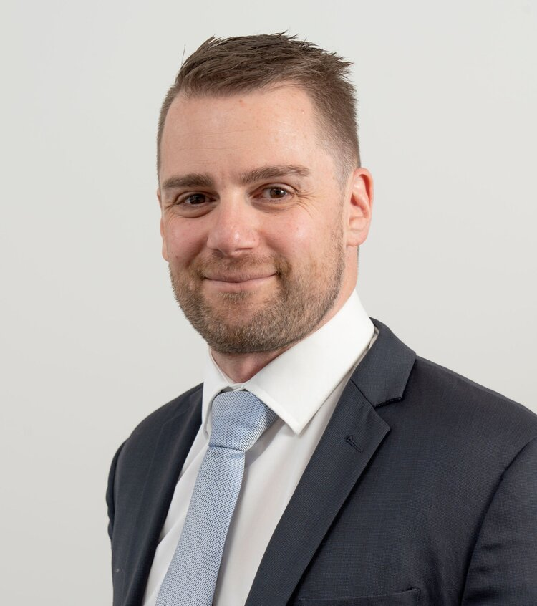
Ashley Mason – Snr Broker
Ashley joined Frank in December 2019 as a Senior Broker in the Financial & Professional Risks team in Wellington. His experience includes having worked 15 years for two multinational Insurance Brokers, specialising in arranging liability insurance cover for professions & IT sectors.
One particular area that Ashley has focused on is developing bespoke insurance solutions with local and international insurers for his clients. Ashley has also arranged a variety of industry specific insurance covers for several associations & industry groups.
He started his insurance career in 2000 working as a technical claims advisor for one of New Zealand’s largest Fire & General Insurers before moving to an international insurance broking firm in 2004 specialising in liability. Ashley has a Bachelor of Commerce & Administration from Victoria University in Wellington.
E: ashley.mason@frankrisk.co.nz M: 027 282 5050 P: 04 333 0432

Slide 3
Topics for Discussion
Types of Policies & how they work
Key things to get right with policies
How much cover should you have?
Common exclusions
Run-off Cover/Insurance – What is it?
Claim Examples
Questions are welcomed at any point

Slide 4
Main policies to consider
Professional Indemnity
Public Liability
Statutory Liability
Asset Insurance (i.e. Material Damage and Commercial Motor)
Life/Health/Key person Insurance

Slide 5
Professional Indemnity
Indemnifies you for amounts which you become legally liable to pay as a result of an actual or alleged act, error or omission in the conduct of your professional service.
Such as –
Legal costs and expenses incurred
Third party financial loss (not property loss)
Breach of Professional Duty (negligent advice)

Slide 6
Public Liability Insurance
Sometimes called General Liability
Covers damage to other parties property or bodily injury whilst in connection with your business
Commonly contractually required before entering a work site

Slide 7
Statutory Liability
Covers the legal defence cots, fines and reparations imposed under certain sections of Acts of Parliament.
Most common statute claimed against is Health & Safety Act
IMPORTANT NOTE – Insurance against fines incurred under the Health & Safety Act is not permissible by law. However, the defence costs incurred from actions brought under this Act remain Insurable, including reparations.

Slide 8
Asset Insurance
Material Damage
Covers accidental loss to physical property owned by you
Commercial Motor Vehicle
Covers accidental damage to your vehicle or damage caused to third party property by your vehicle

Slide 9
Life/Health/Keyperson Insurance
Contingency/Disaster planning
What happens if you can’t work?
What happens if a key employee is unable to work?
Work with an adviser to understand what can be covered, what your options are and what works best for your situation.

Slide 10
Key things to get right
Business Description
Your liability policy will cover you for the business conducted by you as specified in the Policy Schedule as your business description
It is imperative to accurately cover all activities you offer to your clients that a claim may arise from
As your skills and offerings to client change, so should your business description
If is not noted in your business description = NO COVER

Slide 11
Key things to get right
Retroactive Date
Your policy will cover all activities taking place on or after the “Retroactive Date”
Ideally, this should align with when you started your business so as all work is covered (if the Insurer will offer it)

Slide 12
Key things to get right
Defence Costs
Ideally, these need to be ‘in addition’ to your limit of indemnity or catered for via a separate policy
If they are ‘included within’ your limit of indemnity, you will potentially not have access to defence costs in the event of a claim

Slide 13
Key things to get right
Proposal Forms
These are required by all insurers in order to provide you with terms
Every year the insurer assess the changes in your business and provides terms for the new period
Prompt and accurate return of these means your cover will remain in place. Your adviser should be able to assist you with any queries in relation to the forms

Slide 14
How much cover is right?
Several factors will drive this;
Contractual requirements
Size of work carried out (both contract or individual jobs being worked on)
Personal risk tolerance
There is no right answer

Slide 15
Common Exclusions
Building Defects (Leaky/Wet building)
Asbestos/Pollution
Assumed Liability
The first two can be covered by some insurers (sub-limited cover). All insurers exclude these as standard so if this important and you are working in these areas, let your adviser know so they can discuss with the Insurer

Slide 16
Run-off Cover/Insurance
When a business ceases trading, they can purchase what is called ‘runoff cover/Insurance’
A ‘Run-off’ policy covers work done by a business in the past (up to the point you decide to cease trading)
This is due to the ‘Claims made’ nature of liability policies. i.e. they will only respond to a claim if an ‘active’ or “run-off’ policy is held.

Slide 17
Claim Example
Negligent Survey Report
Residential survey failed to identify cracking in the ground floor wall adjacent to a tree.
Following the purchase of the property it required substantial underpinning
Claim settled for: $45,000

Slide 18
Claim Example
Pre-purchase claim
An inspector undertook an inspection of a property.
Failed to identify key areas of failure (cladding and internal moisture damage).
Buyer used report then discovered all the issues, Proceedings were issued
Claim settled for: $325k (only had cover for $250k of loss)

Slide 19
Claim Example
Change in Business Description
Client took out a policy which only detailed “Pre-purchase Inspections” as their business description.
As the business was not doing so well, they decided to offer other services which included “Architectural services” and proceeded to offer these additional services to their clients
Claim arose due to an issue with a design of a building
Claim was declined as Insurer was not advised of the new business activity
Uninsured Claim Amount: $30,000

Slide 20
Claim Example
Incorrect Retroactive Date
Client purchased a new PI policy effective from 01 Jan 2018. He was not interested in insuring for his historical work
Claim arose for a pre-purchase report which failed to identify significant issues form a report dated 01 May 2017
Proceedings issued against the client
Policy was unable to be triggered as work fell outside of the retro date
Client was then responsible for all defence costs and settlement costs
Uninsured Claim Amount: $750,000

Slide 21
Questions?

