Slide 1
Inspection and Compliance of New Truss Installation Methods
Sriraj Varier | Structural Engineer Pryda ANZ

Slide 2
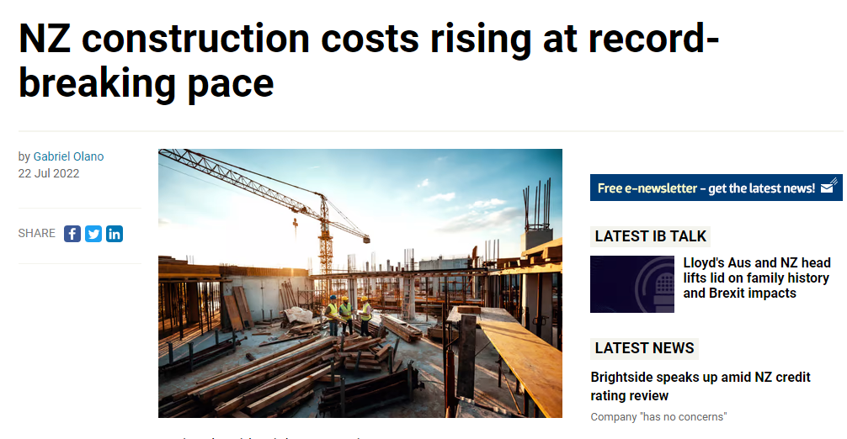

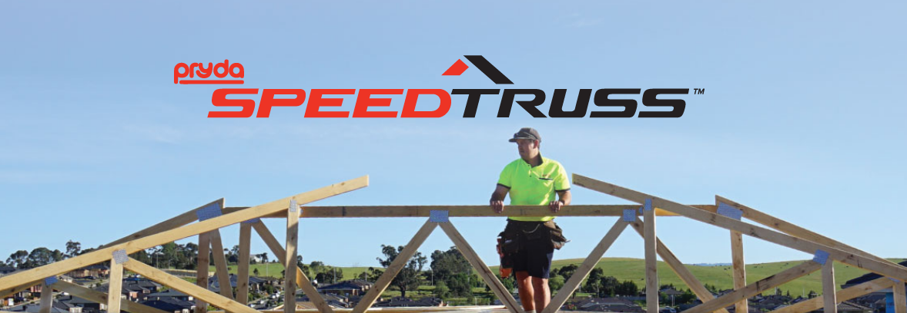

A glimpse on the updates to the H1 Building code
Market situation
Impetus for change
Pryda SpeedTruss
Features
Inspection
Compliance
Pryda FastFix Screw
Features
Inspection
Compliance

Slide 3
A WORD ABOUT H1
Impacts on the Frame & Truss Sector

Slide 4
THEMES
Go as far and fast as possible – without breaking anything in the system
Transition period – extended to May 1st, 2023
To achieve significantly higher R-values, the sector would need to significantly change the way building elements are designed and constructed.
Current design and construction practices in New Zealand can still be used with the new R-values.
Need for comprehensive sector guidance and education

Slide 5
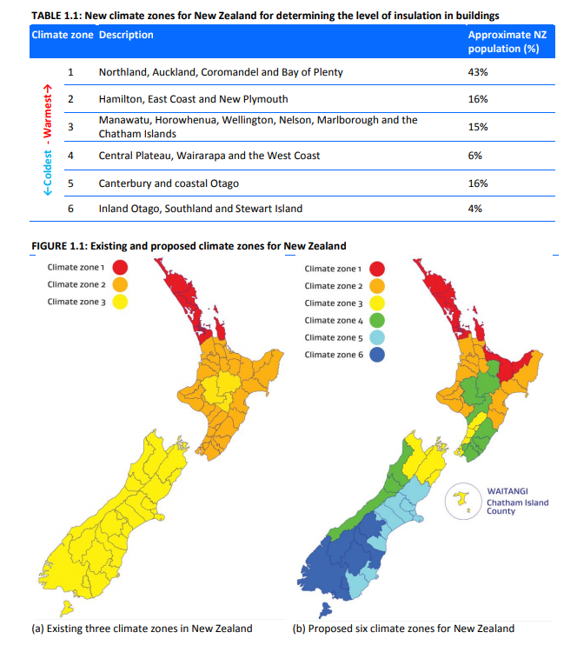
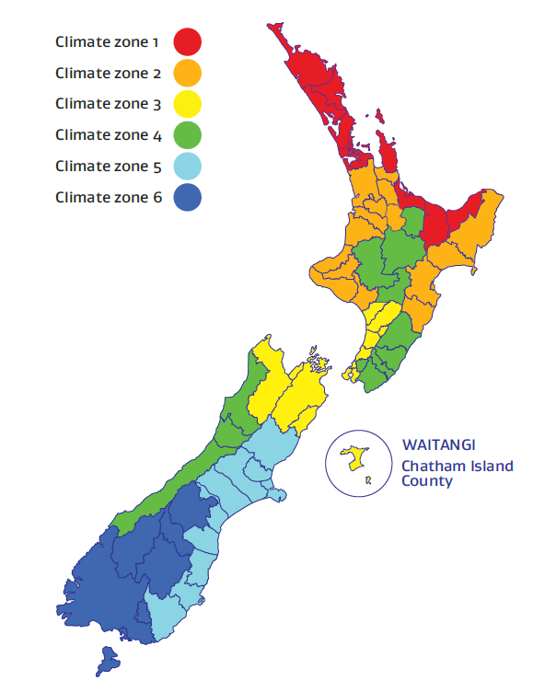
NEW CLIMATE ZONES

Slide 6
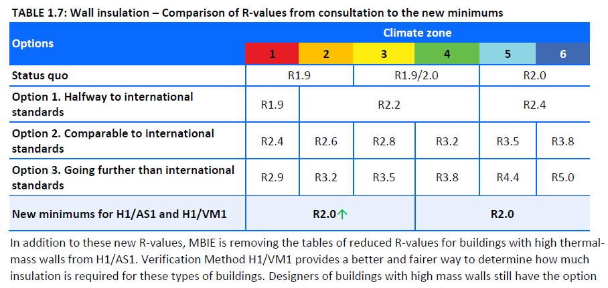
Proposed Changes to Wall Insulation (Housing & Small Buildings)

Slide 7
IMPACTS ON WALL FRAMING
Strong feedback that changes to insulation requirements would have to consider timber supply issues and framing design
More insulation = less timber = different framing practices required
Difficult to achieve for residential buildings across the country currently
Therefore, requirements for walls in residential building are mostly unchanged
The settings will still allow current framing practices to be used
Designers will still have options to consider the amount of timber on the total insulation value of the wall
To help get us to higher performance levels, MBIE has already commissioned a revision to NZS 3604, and is working with BRANZ to revise their House Insulation Guide
Bigger changes, taking a more holistic view of structures, are coming

Slide 8
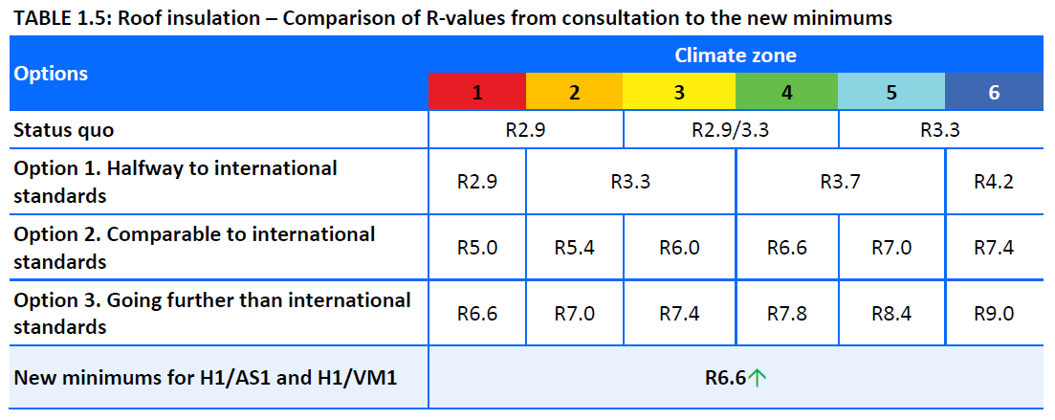
Proposed Changes to roof Insulation (Housing & Small Buildings)

Slide 9
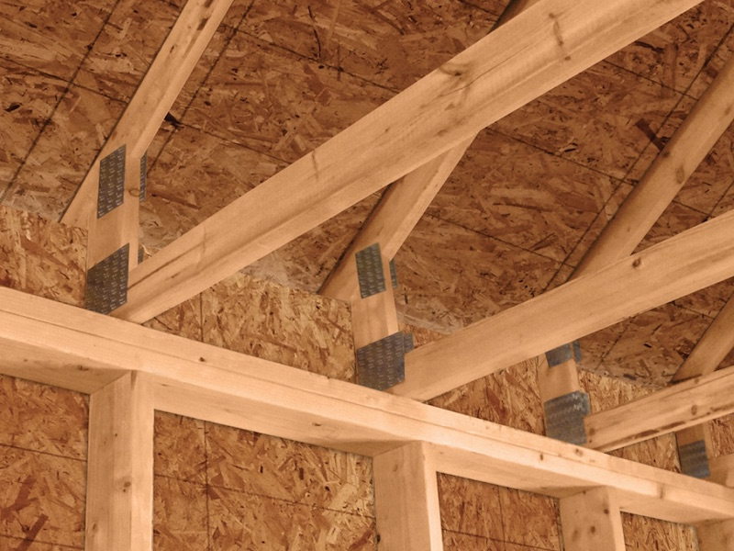
IMPACTS ON ROOF FRAMING
In buildings with a roof space, the thicker roof insulation could generally be accommodated without any significant changes to the roof framing
Some extra insulation already being used (by choice) in South Island
May increase prevalence of raised heel trusses
Already generally required in South Island low pitch roofs

Slide 10
STATE OF THE MARKET
It’s busy

Slide 11
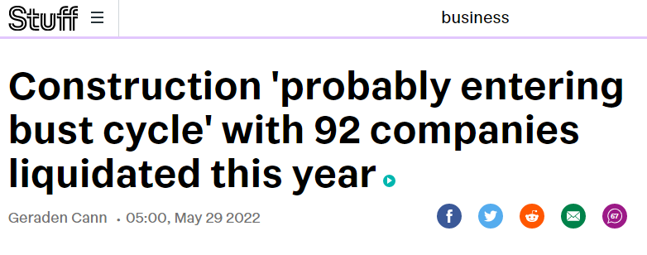
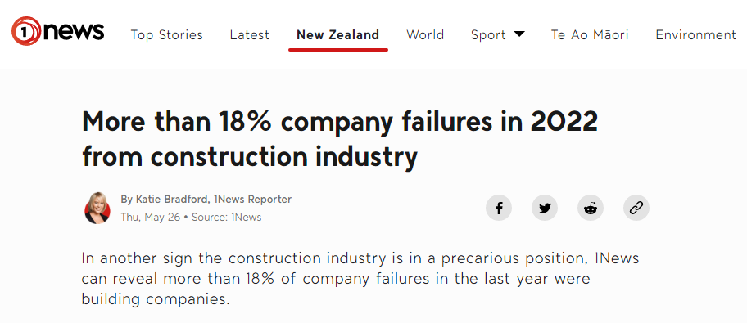
State of the market

Slide 12
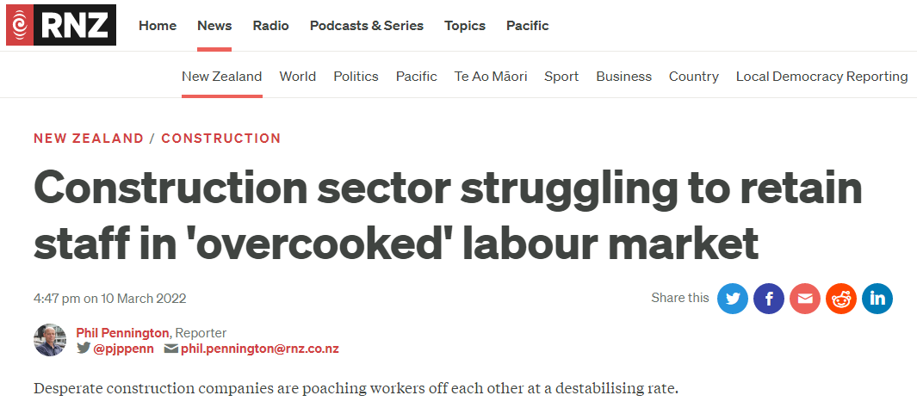
State of the market
How do we build more quickly?
How do we build with less labour?
How do we maintain or improve safety & compliance?

Slide 13
screw solutions for trusses
The newest (260 year old) innovation

Slide 14
Screw solutions for trusses
On site vs off site installation
Temporary fixings
Engineering design
Documentation and inspections

Slide 15
Pryda speedtruss

Slide 16
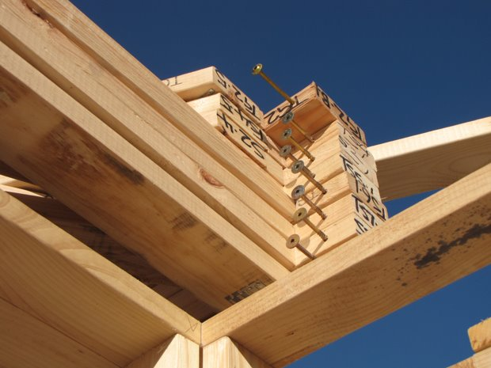
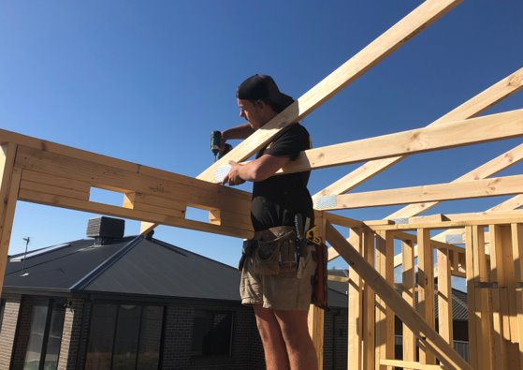
OFFSITE SOLUTION – pryda speedtruss

Slide 17
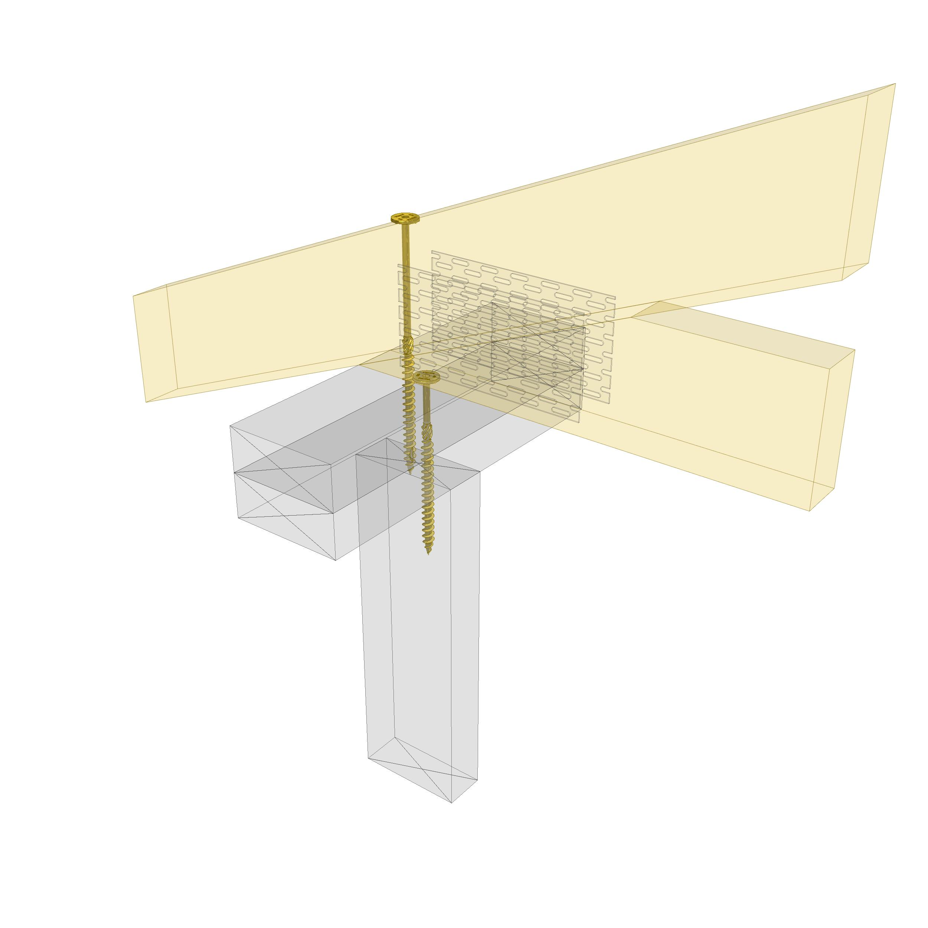
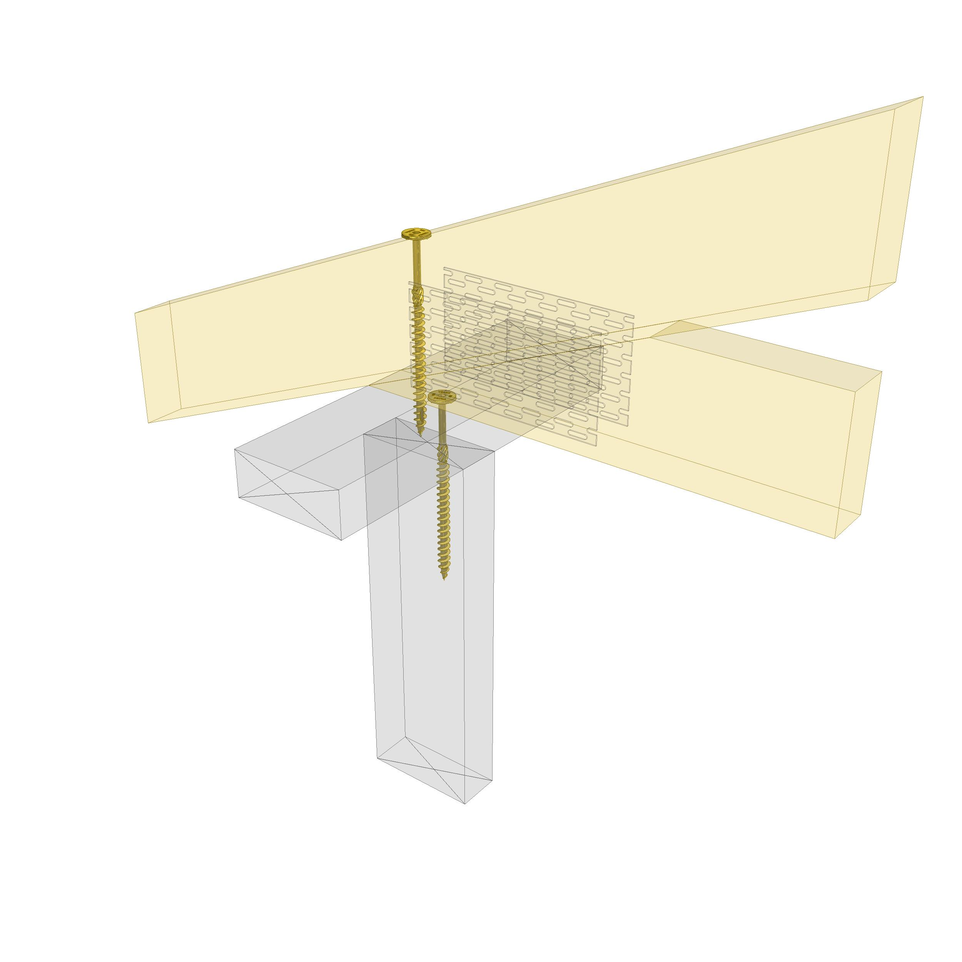
OFFSITE SOLUTION – pryda speedtruss™
SpeedTruss screws obtain their tie down capacity based on the withdrawal capacity of screws into the supporting member.
In the case of SpeedTruss screws the ‘supporting member’ is deemed to be the wall top plates and so the capacity of the screw is determined by how much of the thread of the screw is embedded into the depth of the top plate
This depth of penetration is a factor of the heel depth of the truss at the location of the screw over the wall and the total thickness of the top plates used.

Slide 18

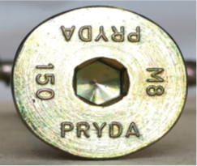
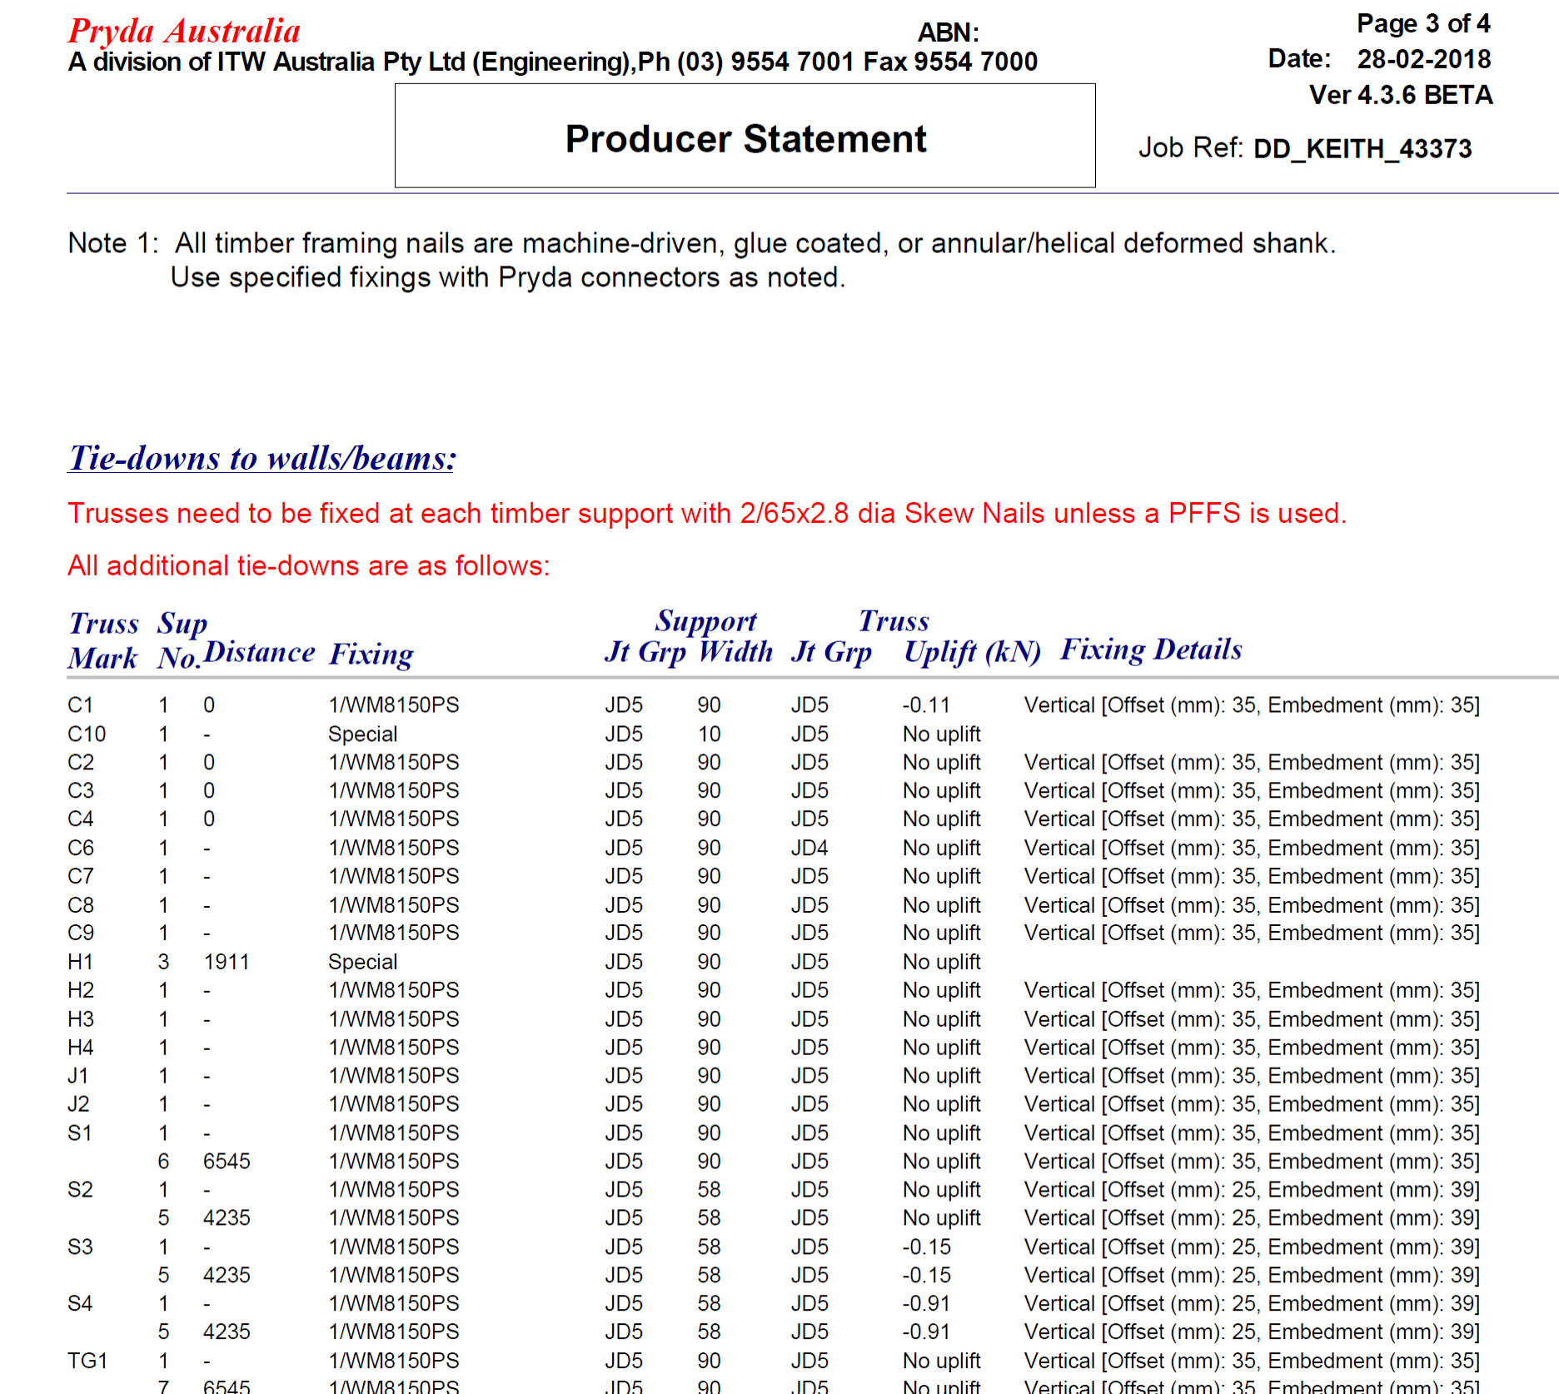
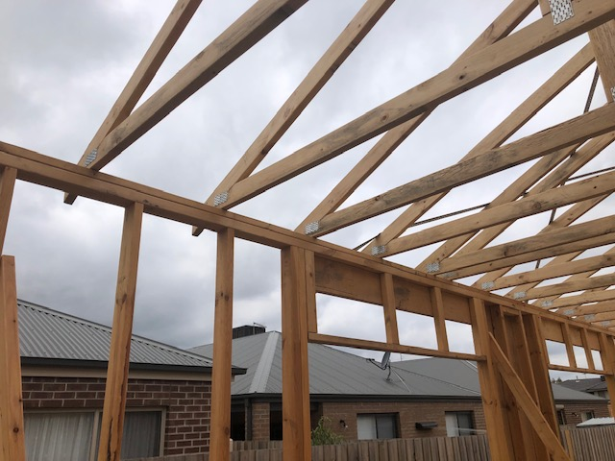
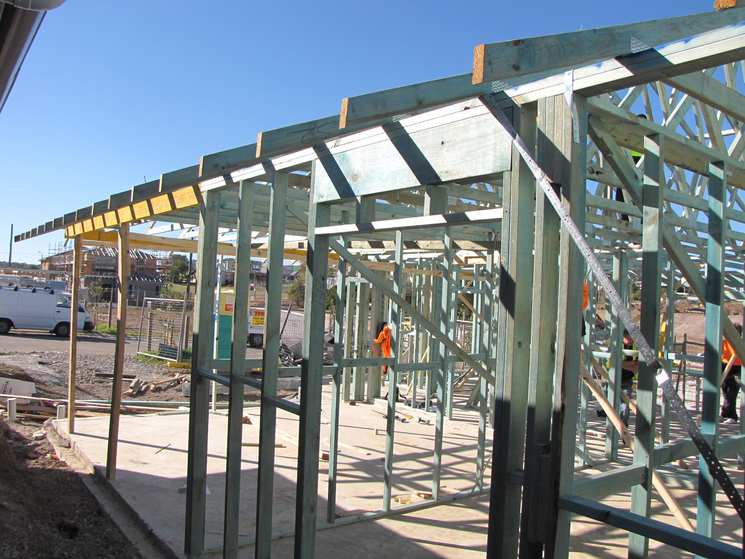

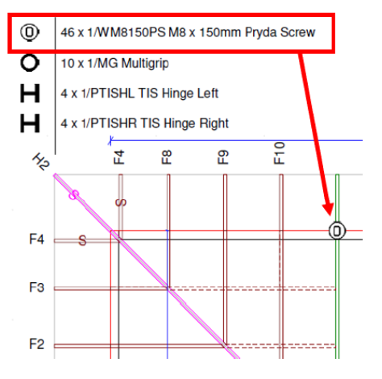
SPEEDTRUSS™ IN ACTION
Installation
Detailed connection reference-Producer Statement
Identification label for Certification/Inspection
All screw heads are embossed with length and gauge.

Slide 19
Pryda FASTFIX
Stud to Wall-Plate Screws

Slide 20
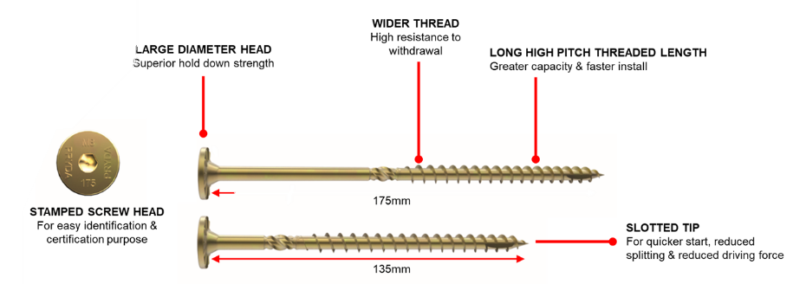
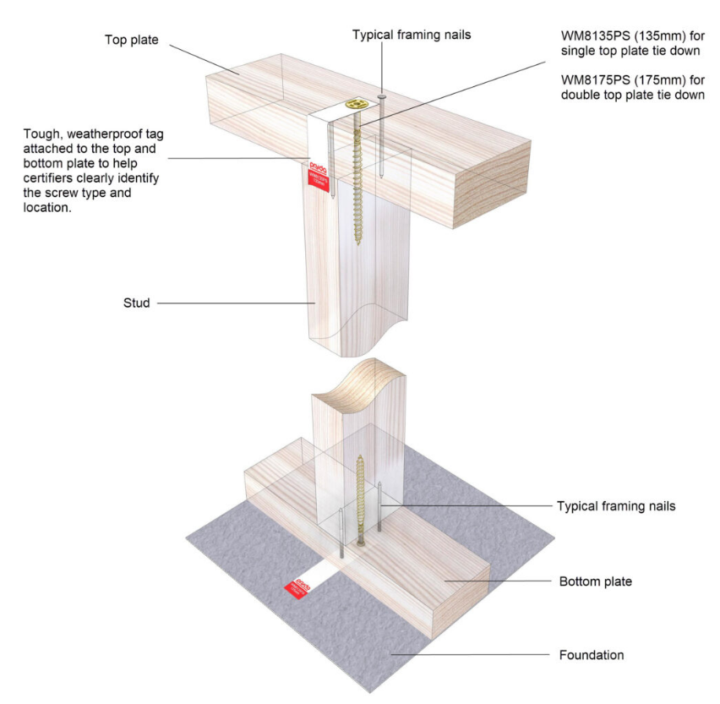
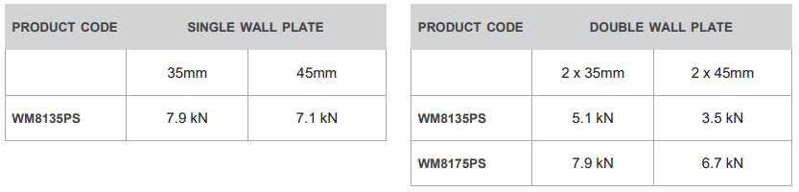

OFFSITE SOLUTION – pryda FASTFIX
Retail availability – NOW!
Direct replacement for straps for stud tie-downs and lintel uplift connections
Ease for inspection – Pryda Screw Tags

Slide 21
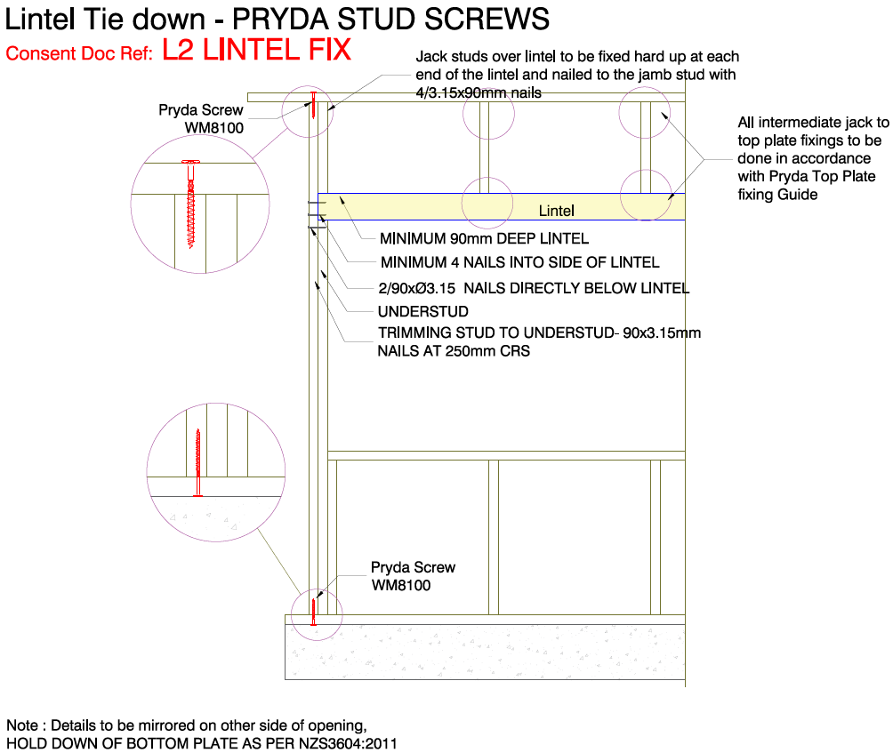
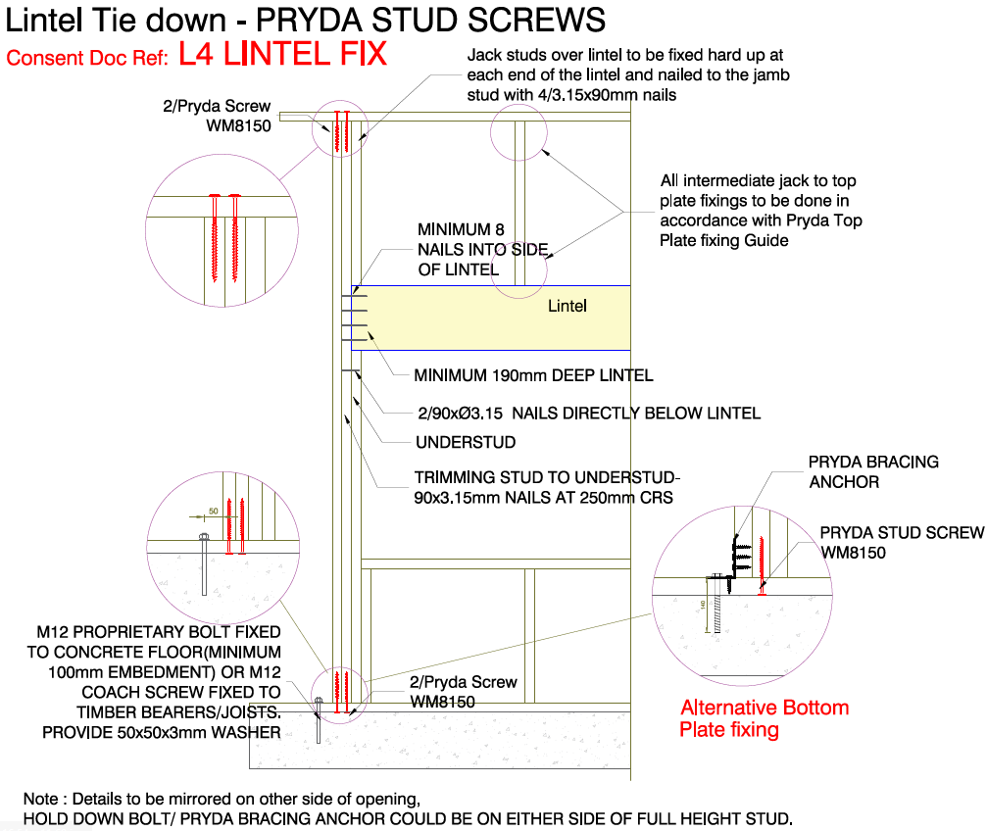
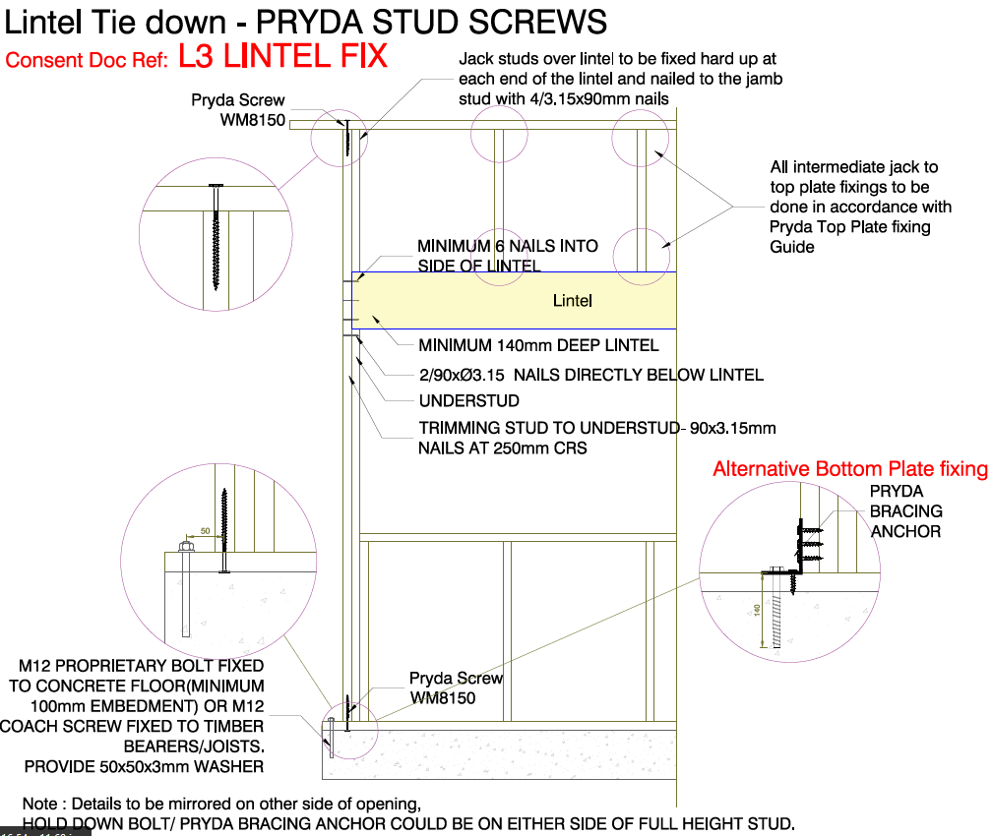
PRYDA FASTFIX LINTEL CONNECTIONS
L3 Uplift capacity – 8.0 kN
L2 Uplift capacity – 2.8 kN
L4 Uplift capacity – 14 kN

Slide 22
CONTACTS
ENGINEERING
Sriraj Varier – Structural Engineer
svarier@prydaanz.com
8 Orbit Drive, Albany. Auckland 0632
(m) 027 266 1120
SALES
Steve White – Sales Manager
swhite@prydaanz.com
8 Orbit Drive, Albany. Auckland 0632
(m) 021 790 951
THANK You!

