Slide 1

FEB and Design Review Process
A Fire and Emergency Perspective

Slide 2
What Is The FEB Process?
Fire Engineering Brief
International Fire Engineering Guidelines (2005)
Documented process that defines the scope of work for the fire engineering analysis
Tool to manage consent risk for performance based engineering
More common since 2012 (C/VM2)
Determination 2017/040

Slide 3

What Is The FEB Process?
Scale of FEB process is flexible
Can be a few emails
Major document / regular stakeholder meetings
Pre-application meeting equivalent to FEB process
Process value depends on the designer
Tick box exercise
Meaningful project discussions
May include non Building Code objectives (rare in NZ to date)

Slide 4
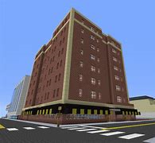

Benefits of the FEB process
Facilitate innovative design
Opportunity to raise other legislative requirements that may impact on the project
Smoothing consenting process
Opportunity to capture non-code objectives in a robust manner

Slide 5
Can You Require an FEB?
Discussed in depth in Determination 2017/040
Conclusion
It is required for C/VM2 designs
It is ‘prudent’ for alternative solutions
This is also inline with MBIE guidance (issued 2018)
Is a C/VM2 design without an FEB an alternative solution?

Slide 6
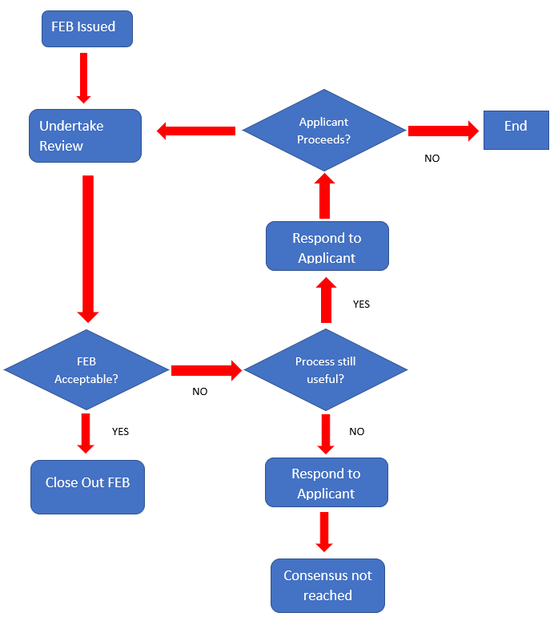
Fire and Emergency FEB Process

Slide 7
What is the BCA’s role as a stakeholder?
If the BCA does not have fire engineering expertise, what can you contribute?
Potentially quite a lot…
Choice of peer reviewer (especially for complex projects)
Building history (outstanding code compliance issues, non-consented works)
Expectations on extent of assessment
Early discussions on proposed waivers
Can requirements of the proposed design be reflected on the compliance schedule
Any project staging issues
Documentation expectations
Other legislative requirements e.g. council bylaws, planning requirements, fire fighting water supply etc

Slide 8

Level of Agreement
Consent risk is significantly reduced when parties are in agreement
A lack of agreement (or not doing the FEB) means associated consent risk remains with the applicant
The BCA remains final arbiter → understanding all parties perspective important for your decision making

Slide 9

Consequence of Disagreement
Disagreement on fundamental issues can significantly delay the project
- Determination 2017/040 resulted in a 1 year delay
- Determination 2018/064 resulted in a 2 year delay
Both projects required a redesign of the building to achieve compliance

Slide 10
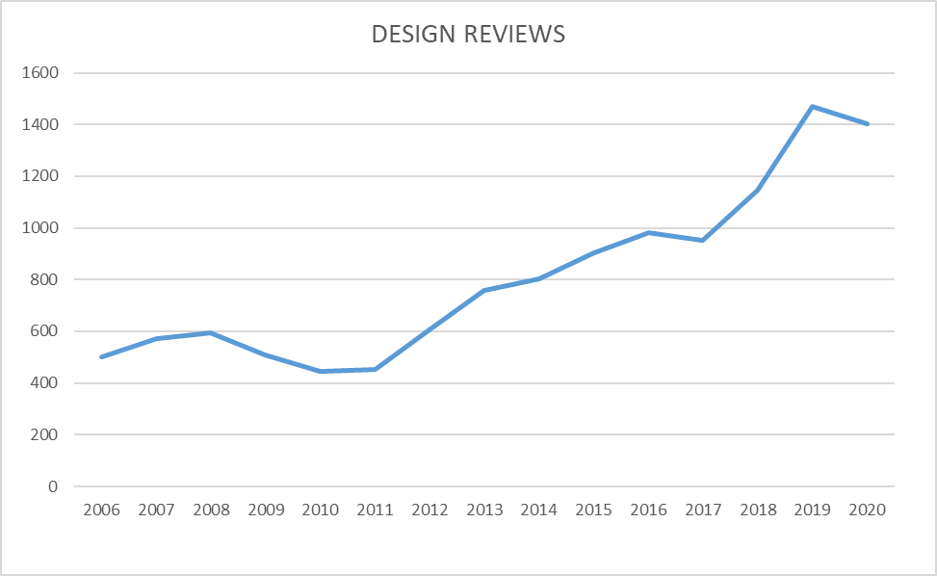
Design Review
Review of consents documentation
Requirement under Section 46 of the Building Act
Consider whole design not just fire report
Huge growth in workload over last 10 years

Slide 11
Jobs Including FEBs
Review that final design is in line with inputs and methodology agreed.
Consideration of any ANARP
Confirmation that items deferred to consent have been addressed
If ‘Consensus not reached’ then has the issue been resolved or does it become a comment

Slide 12
Completeness of Documentation
Comment intended to be a check that the requirements of the fire design have been reflected in the balance of the consent documentation
Simply stating a requirement does not demonstrate compliance
Surface Finishes – looking for a schedule
Fire rated construction details – ‘fire rated coloursteel’
Construction monitoring – consideration of design build elements

Slide 13

Questions

