Slide 1

3604- Geotechnical-
A Standard Discussion

Slide 2
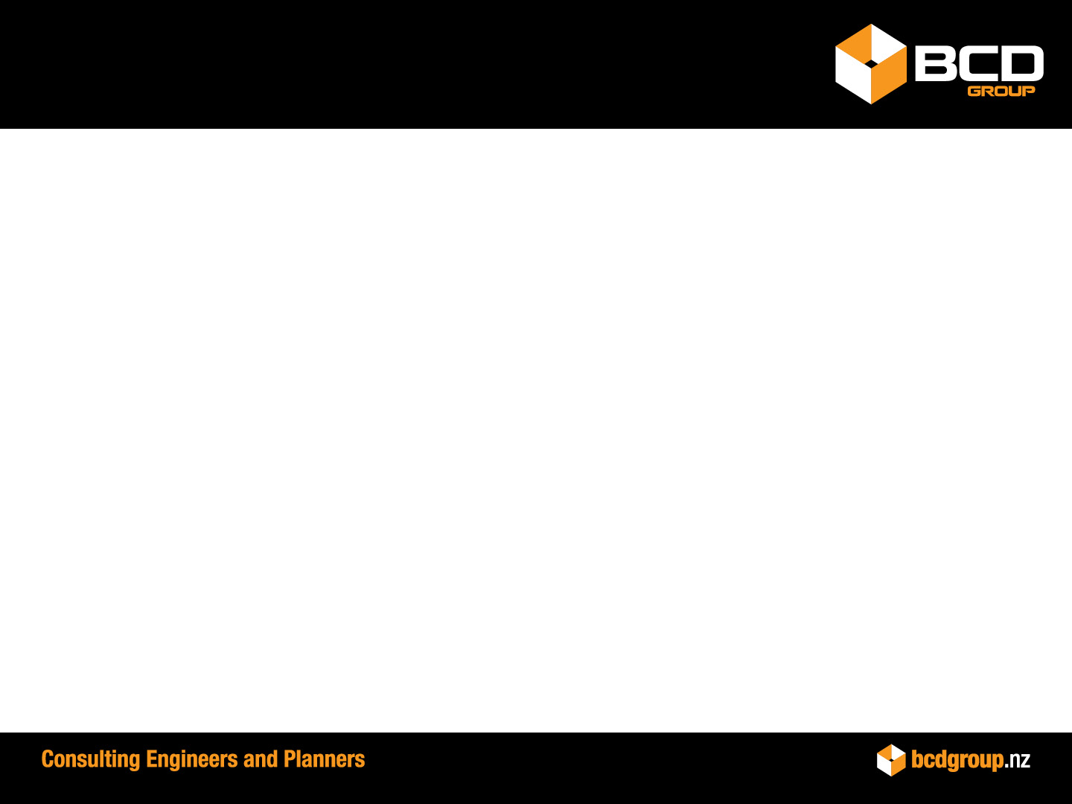

PRESENTATION AIMS
Review of 3604 and what its objective is.
What are the most recent changes?
Where can we find the information and latest updates?
Where are we going? The gaps and how do we fill them?
Geotechnical Reports, recommendations Vs design.
The challenges for Council.
What are the impacts on Councils?
What solutions are available to Councils?

Slide 3
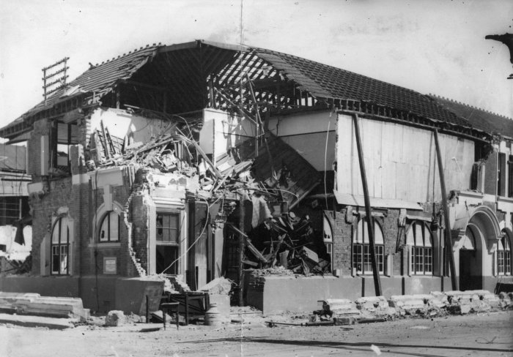
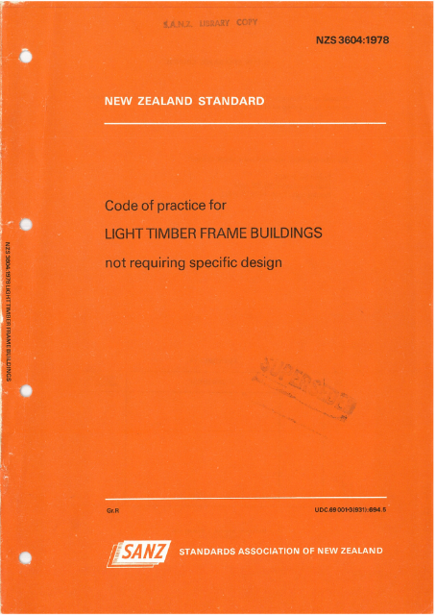
PAST, PRESENT AND FUTURE
First codes after the 1931 Napier earthquake.
NZS 1900: Chapter 6.1:1964 Construction requirements for timber buildings not requiring specific design.
NZS 3604 by the Standards Council in November 1978.
First revision was in 1981 and considerably amended in 1984.
Then revised in 1990 in response to user demands.
NZ Building Act 1992 released and many years of research into the actual performance of timer structures.
Revised in 1999 and recognised as an Acceptable Solution under the New Zealand Building Code.
Latest version in 2011 and was being finalised just as the Canterbury earthquake sequence occurred.

Slide 4
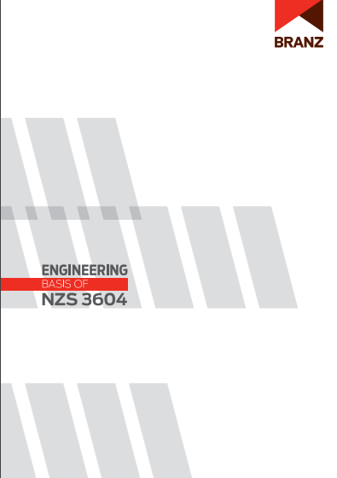
HOW DO WE FILL IN THE GAPS?
BRANZ https://www.branz.co.nz assess many of the new changes.
They have research and guides with information and what should be considered.
Up-spec is one area of their work and is currently directing users to correct standards
Notes:
We have many different standards and guides that have been published since 2011 due to earthquakes, advances in materials technology and innovation.

Slide 5
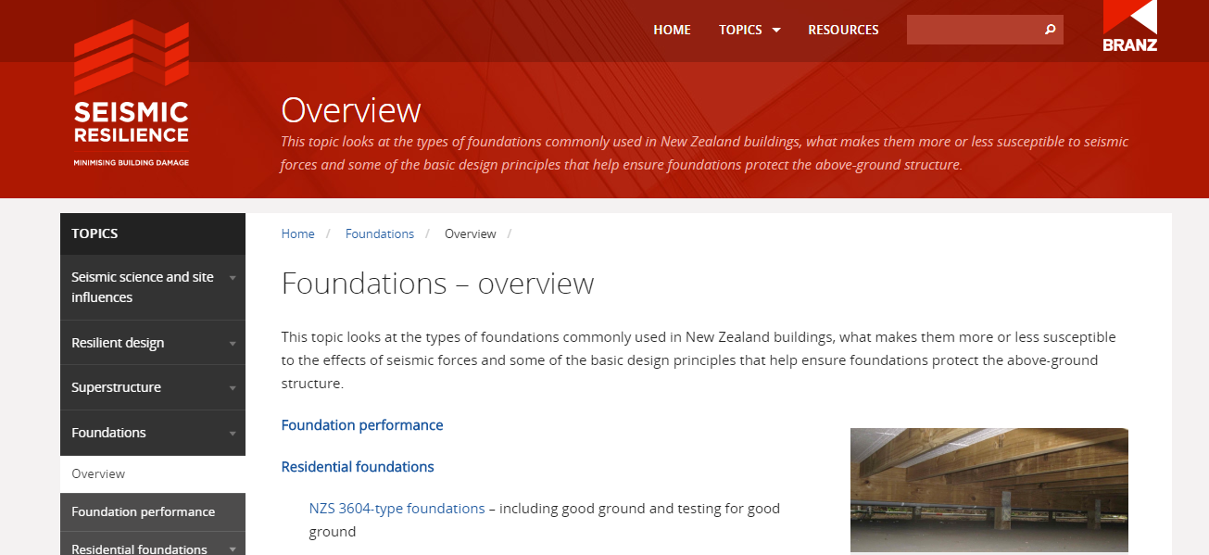
BRANZ- SEISMIC RESILIENCE
A new branch of BRANZ is Seismic Resilience. Gives both Geotechnical and Structural guidance. This is a good starting point to check the changes and impacts on 3604 due to earthquakes.

Slide 6
3604 AND ADDITIONAL
Compressible ground
Expansive soils
Excessive movement
300kPa
Liquefaction
The majority of residential building foundations in New Zealand are constructed to comply with Building Code.
Following the Canterbury earthquakes, the MBIE refined the existing definition of ‘good ground’ in Acceptable Solution B1/AS1 to exclude ground in the Canterbury earthquake region that is subject to liquefaction and/or lateral spread.
Good ground is defined as soil or rock capable of 300 kPa, but excludes:
Potentially compressible ground
Expansive soils
Any ground which could foreseeably experience movement of 25 mm or greater.

Slide 7
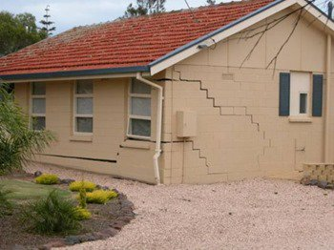
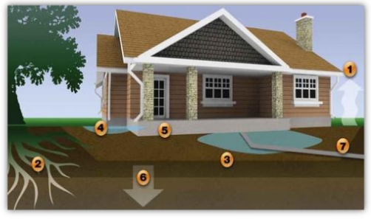
COMPRESSIBLE GROUND SETTLEMENT
“Potentially compressible ground such as topsoil, soft soils such as clay which can be moulded easily in the fingers, and uncompacted loose gravel which contains obvious voids.”
“Any ground which could foreseeably experience movement of 25 mm or greater for any reason including one or a combination of land instability, ground creep, subsidence (liquefaction, lateral spread – currently for the Canterbury earthquake region only), seasonal swelling and shrinking, frost heave, changing groundwater level, erosion, dissolution of soil in water, and effects of tree roots.”

Slide 8
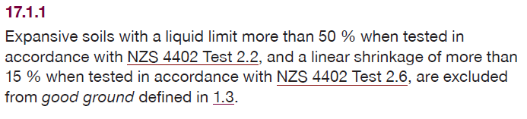
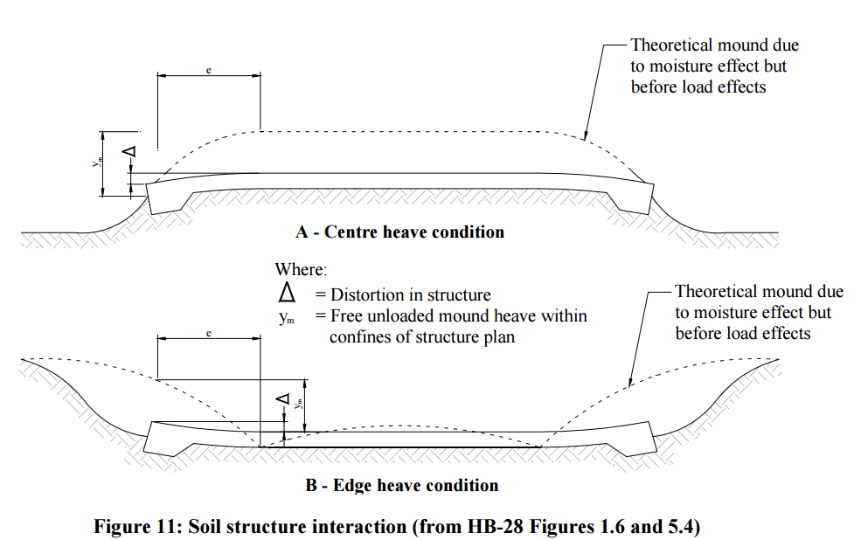

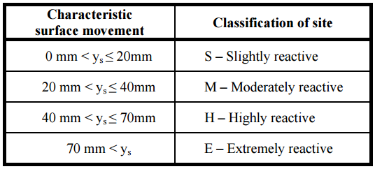
EXPANSIVE SOILS
Hamilton Ash LL 40-95% but loses the behaviour after the initial shrinkage
AS 2870:2011- Residential slabs and footings
BRANZ 2003 Study Report

Slide 9
REACH OF 3604
BRANZ Engineering Basis adds more considerations:
Foundations of adjacent buildings show no signs of settling or low bearing strength.
No evidence of landslides in the vicinity.
If good ground is not met or is more complex, it is subject to specific engineering design and must demonstrate compliance with the Building Code (B1).
Compressible ground
Expansive soils
Excessive movement
300kPa
Liquefaction
Landslides and slopes
Buried Services

Slide 10
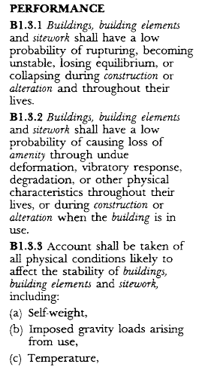
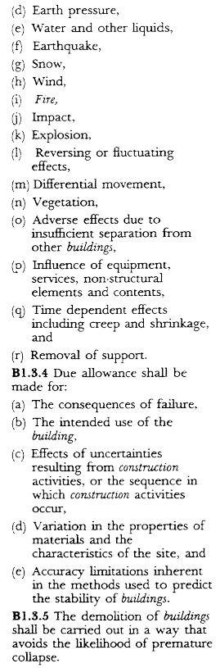

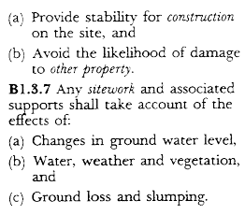
REACH OF 3604

Slide 11
RECOMMENDATIONS AND DETAILED DESIGN
In reports we often see recommendations and designs.
  When there is insufficient information regarding the building and site works
  Used when providing options for cost estimation
What can Council do?
  Check the report limitations and scope
  Ensure any recommendations for further assessment have been undertaken
  Ensure plans show accurate existing levels and the proposed levels
  Retaining walls on boundaries may be affecting another consent already approved or still being processed
  Check that the works shown are in line the recommendations or refer it back to the geo-professional to confirm and sign the drawings
  This may highlight the need for design and a PS1
Discussion

Slide 12
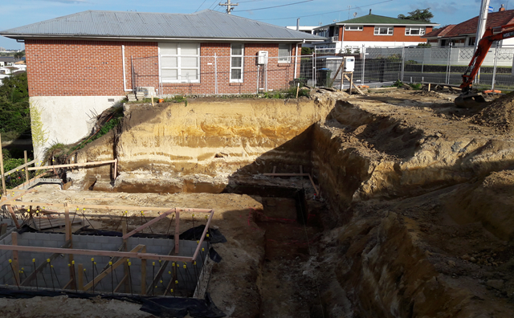
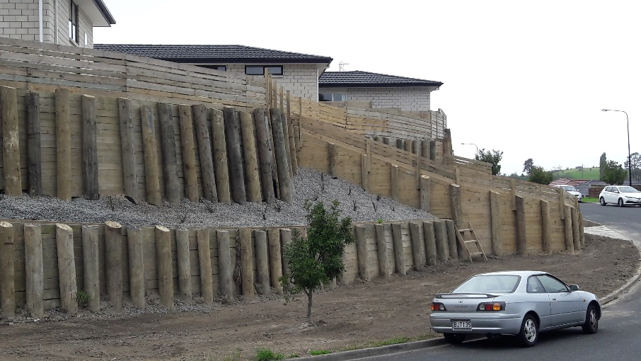
RECOMMENDATIONS AND DETAILED DESIGN
Site Works
Unless a site is very level, you need to make it level. This can result in:
Excavations undermining existing retaining walls
Fill being placed above existing retaining walls
Exposing soils deeper than those tested
Issues with sequencing of works
What can Council do?
Ensure geotechnical reports describe how the proposed works interface with adjacent land
Require sequencing / temporary works to be considered – Worksafe NZ
If an inspector sees a wall that was not approved or wall being affected query it
Discussion

Slide 13
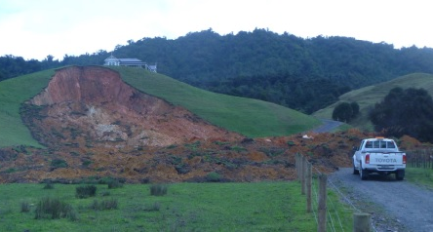
THE CHALLENGE FOR COUNCILS
Risks often aren’t apparent unless assessed by a competent geo-professional e.g. Large scale instability, historic fills, liquefaction, settlement.
Use the CPEng Register and confirm the practice area of engineers signing off on geotechnical work.
Use a peer review panel to enable the engineering industry to self-regulate itself
Notes:
We now have many more geo-hazards to consider but the same approval period but are accountable for much more risk.

Slide 14
POLICY DISCUSSIONS
Discussion
Geotechnical Risk Assessment in the planning and subdivision stage,
3604 assessment in the building consent phase.
For | Against
Council can concentrate on specific roles, making for more efficient processing | Many different opinions as to what a suitable geotechnical completion report should contain
Council knowledge and specialism grows | Developers will resist having to spend the money for the assessment
Huge cost and time saving | Developers won’t want to spend the money to fix the problems

Slide 15
GEOTECHNICAL RISKS & GUIDANCE
Geotechnical Risk | Relevant Guidance
Bearing Capacity | NZS3604:20114 “good ground”
Earthquake hazards | MBIE & NZGS Modules 1-4. NZTA Bridge Manual. ASNZS1170.0/5
Compressible Ground | NZ Building Code limits, otherwise this is subject to individual engineer
Expansive Soils | AS 2870:2011- Residential slabs and footings . BRANZ 2003 Study Report
Excessive Movement | Tomlinson Meyerhof
Landslides and Slopes | MBIE (TBC). NZTA Bridge Manual. NZGS and BRANZ report. Australian risk assessments
Buried Services | DS-10 TCC
Geothermal | GNS and international studies
Ground Rupture | MFE Wellington
Erosion | Various local guides. Rivers and coastal processes area of expertise
Tomos | Some area specific GNS studies exist
Flooding | GIS Flood layers
Collapsible soils | This can be shown on liquefaction analysis, CLiq software and CPET software
Corrosive soils | International guides such as BRE
Soil contamination | NES process
Fill material/mining | International guides (Coal mining NHBC studies from UK)
Impact of Development | What impacts does the proposed building have on the surrounding area?
Notes:
Now is the chance to influence the RITS geotechnical sections

Slide 16
SOLUTIONS FOR COUNCILS
Immediate Council Needs.
Standardised risk list from the RITS section. DS-10 Tauranga City Council has partly broken down risk categories and is light on detail, however performance requirements are well defined.
Training from a panel of respected engineers for each of these risks and the published guidance.
Each report to have a checklist or minimum content.

Slide 17
SUMMARY
NZS3604:2011 is a means of compliance for limited types of a timber framed structure.
It takes fundamentals of bearing capacity, settlement and slope stability but has limitations and outside of the property boundary.
These gaps can be filled with NZ guidance documents
Identify when you have buildings outside of 3604 needing specialist skills and peer review.
More discussion with Councils for needs around regulation and setting of standards.

