Slide 1




Auckland Branch
Training & Networking Event
Presented by - Nick Hill, Chief Executive
Alexandra Park, Greenlane, Auckland
Wednesday, 17 July 2019

Slide 2



It’s YOUR Institute!!
What you contribute ensures you are winners!
We need your support,
so we can support you!

Slide 3
Agenda
AGM 2019 Overview
Annual Financial Report
2019 Strategic Platforms Review
Personal Development for BOINZ Members
Workstreams
Membership
Marketing
Training
HR
Advocacy
Education and Training Delivery Strategy
Qualifications Update
Training Update
Building Legislative Reform
Recap from April Meeting

Slide 4


Annual Membership
2016 2017 2018
1201 1236 1238
Members per Branch
Northland 58
Auckland 337
Waikato/BoP 193
East Coast 52
Central 108
Wellington 91
Nelson/Marlborough 58
Canterbury/Westland 183
Southern 159
Training Academy 2018
36 Courses
3028 Attendees
Branch Networking & Training Events
Per Year
Northland 4
Auckland 9
Waikato/BoP 4
East Coast 4
Central 4
Wellington 4
Nelson/Marlborough 4
Canterbury/Westland 7
Southern 4
*Central, Waikato/BoP, Southern, Northland = ¾ - Full Day Meetings
34 Accredited Building Surveyors Members
Northland 2
Auckland 10
Waikato/BoP 7
East Coast 0
Central 4
Wellington 3
Nelson/Marlborough 1
Canterbury/Westland 5
Southern 2
Branch Meeting Average Attendee Rate by
Branch Size
Northland 30%
Auckland 25%
Waikato/BoP 15%
East Coast 38%
Central 18%
Wellington 17%
Nelson/Marlborough 18%
Canterbury/Westland 27%
Southern 11%
HR Division
2018 Launch
“A Career in Building Surveying” Booklet
Conference Councils
Represented
2017 2018
42* 38
*50th Anniversary
Diploma in Building Surveying Statistics – Dec 2018
Students Registered In-Employment Pathway = 78
Students Registered Full-Time & Part-time = 27
Students Graduated (Full-time) = 12
2017 vs 2018
Likes 186 281
Followers 207 297
Straight Up 2016 2017 2018
Unique Visitors 510 599 451
Issue Views 810 1,029 715
Page Views 11,837 17,598 9,711
HR Division Candidate Enquiries
NZ = 33%
SA = 28%
UK = 17%
Canada = 22%

Slide 5
AGM 2019
Presidents Report Overview
Booming construction economy - all sectors involved under significant pressure.
Design companies & builders struggling to find skilled labour to deliver quality outcomes.
BCA’s looking to technology to drive efficiencies - they too are finding they are under resourced.
Evolution is the bedrock of resilience, the wider build sector is delivering, but from a low base.
For many years the Institute has been the vanguard of educational, training and skills support.
In-Employment pathway for the NZ Diploma commenced February 2018.

Slide 6
AGM 2019
Presidents Report Overview
Our profession finally has its own technical qualification to deliver much needed resource to support both building control and the wider building surveying sector.
This year the Institute delivered a $63.4k deficit – losses occur from time to time.
Year-End Financials only tell part of the story in respect of our stability and vision.
It is important to deliver immediate, medium and long term benefits to members and the sector.
Towards end of 2018 your Board made the decision to review its strategy and re-define direction – work commenced 2019.
Challenging and quickly changing environment has, and will continue to impact our sector.

Slide 7
AGM 2019
CEO’s Report Overview
Tribute to members for extraordinary job undertaken on a daily basis.
Institute’s purpose is to “Improve the Quality and Performance of the Built Environment”.
Building Surveying professional’s need a robust and well-established understanding of best practice, and a vision for a better performing built environment.
Success means ensuring we have an ability to transform and evolve.
Annual journey very much depends on a mix of events and opportunities.
Institute has many alliances and relationships it can draw on.
2018 year has been the most challenging for the Institute this decade.

Slide 8
AGM 2019
CEO’s Report Overview
Capacity and capability of the building surveying sector, and that of the Institute has been tested.
Climate is a tough one and has reflected in our year-end result.
BCA’s struggled to meet regulatory targets in an environment of increasing consent volumes.
Training and Events experienced pressures.
Impacted support in the development and introduction of the new NZ Diploma in Building Surveying In-Employment Pathway.
Our strategy largely driven by our educational desires.

Slide 9
AGM 2019
CEO’s Report Overview
New Diploma qualification has paid dividends early.
Institute’s Events programmes a significant part of our learning and networking platform.
2018 Conference had lower than normal attendances
Institute looked to diversify
HR Division to support recruitment of building surveyors - minimise skills shortages
Accredited Building Surveyors – vital area of pre-purchase property
Developing knowledge and skills one of our primary functions – advocate knowledge and recruitment uptake across the industry.

Slide 10
AGM 2019
CEO’s Report Overview
Advocacy message linked to our Vision Statement in respect of raising build performance and quality and encouraging the right behaviours.
LBP’s to lift skills and knowledge through a tiered licencing career pathway
Improved building code awareness producing improved consent applications
Independent 3rd Party Certification for critical building product in areas of structure, cladding, fire and health
Thank you for your 2018 support. Strength is in our collective membership. Together we add value to how we perform and serve.

Slide 11

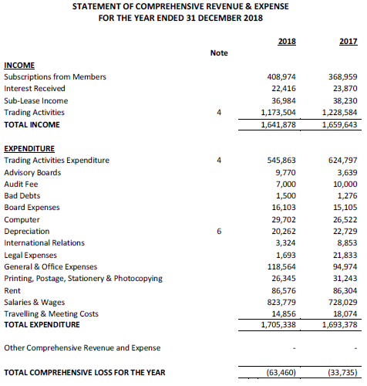
Annual Financial Report

Slide 12
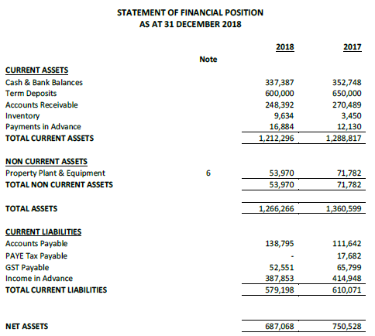
Annual Financial Report

Slide 13
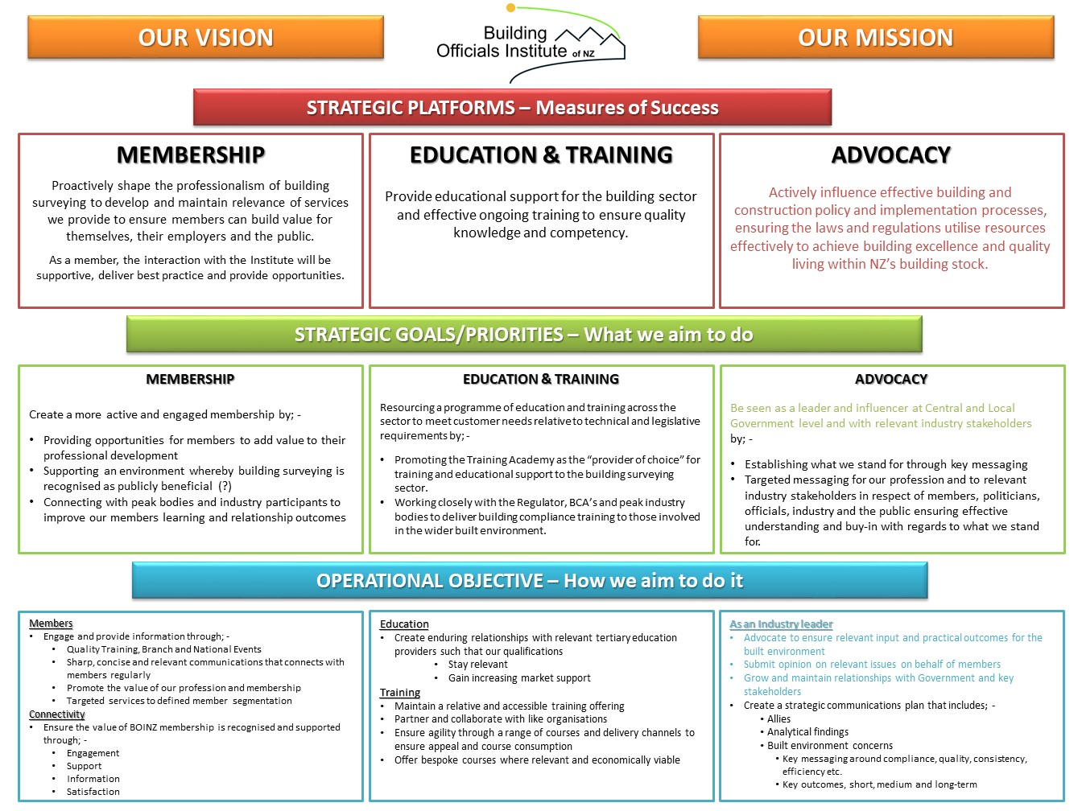
Strategic Platforms Review

Slide 14
Personal Development for BOINZ Members
PERCEPTIONS -- How does the average “punter” see us !!
Historically: The Reality
- BCO”s = Policemen!!
- BCO”s = “Clipboard Charlies”!!
-BCO”s = Failed Chippies ??
A Professional Culture for BOINZ Members:
- “Masters of the Code” = Risk Mitigation
- Consistency
- Drivers and supporters of industry betterment
- Supporters of industry success
- Promoters and deliverers of Public Confidence
Acts & Regulations
BCA/BCO’s
Professions (Architects/Engineers)
Key Trades
Sub Trades

Slide 15

Personal Development for BOINZ Members
Career Pathways
The Making of the Professional
Tertiary Education
Ongoing Competency Training
Career
Challenges
&
Advancement
Personal Training Investment
Work Sponsored Training
Join a professional institute/association
Work Experience
Vocational Qualifications
School

Slide 16
THE MILLENNIALS
Millennials and Generation Z don’t just work for a paycheck — they want a purpose Millennials and Generation Z are no longer pursuing job satisfaction — they are pursuing development. Millennials and Generation Z don't want annual reviews — they want ongoing conversations. Millennials and Generation Z don't want bosses — they want coaches. Millennials and Generation Z don't want a manager who focuses on their weaknesses — they want one who focuses on their strengths. Millennials and Generation Z believe the workplace is not just their job — it's their life. Ref Jim Clifton – It’s the Manager

Slide 17
Personal Development for BOINZ Members
What is a professional institute?
An organisation that acts as a peak body or umbrella for professionals working in the same or similar fields. Institutes/ define the profession and assist members to further their profession through critical and timely industry information, ongoing learning, quality control, products and services, research and advocacy.
What is the purpose of professional body?
A professional institute is an organisation set up to represent and promote the profession itself and the interest of its members in their specialist field of work.

Slide 18
Personal Development for BOINZ Members
Five benefits to keep in mind when considering pursuing a professional certification.
Gain a Competitive Advantage …
Execute Projects with Increased Efficiency …
Increase Your Earning Potential …
Update Your Knowledge and Skills …
Build Professional Credibility …
Professionalism …
Networking …
Career Opportunities …
Grants …
Training …
Advocacy …
Socializing …

Slide 19
Workstreams
Membership
Strategic Statement
Provide a supporting environment that engages and grows our membership through timely information and service delivery that builds strong enduring relationships.
Goals
Build and retain membership
Build Stronger Branch Executive Relationships
Accurate database management
Marketing
Strategic Statement
Deliver value to inspire stakeholder interaction by raising awareness and relevance of the Institute.
Goals
Build brand awareness
Foster and support a culture of professionalism
Deliver relevant and timely products that inspire and contribute financial growth
Training
Strategic Statement
Provide high quality & timely training to empower Building Surveyors & those employed in the associated build & design sectors
Goals
To grow competency & efficiency of Building Surveyors to increase their productivity & associated revenue outcomes
Provide accessible & quality-based training programmes
To be the lead training developer and provider in the sector.
HR
Strategic Statement
Create revenue for the Institute through the recruitment of building surveyors for New Zealand Councils
Goals
Provide essential recruitment resource for NZ’s BCAs.
Act as a platform for international candidates to find building surveying work in NZ.

Slide 20
BOINZ Member Benefits
Branch Networking
& Training
Legislation
Actively influence effective building
& construction policy
Legislation
Standards
Guidelines
Your local support base
Meet industry colleagues
Get Collegial Support
Technical Presentations
Feedback to N/O
Education
& Training
New Courses
Online Training
Discounted Rates
ABS
Communication
HR Divsion
Straight Up / Monthly Updates
Facebook / LinkedIn
MYBOINZ
Daily New
Jobs Boards
Discussion Forum
CV Assistance
Careers Catalogue
International Recruitment
BOINZ Retail Discounts
Perk Plus
Improved App out soon

Slide 21
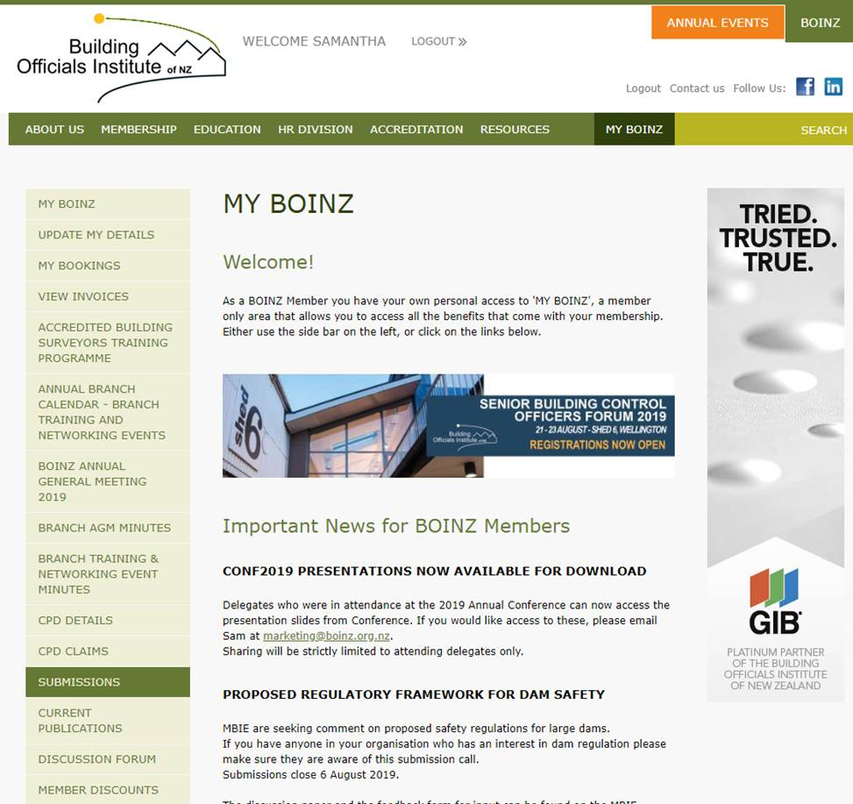
My BOINZ
Access to member restricted area of BOINZ website
Member specific news updates
Bookings – training, conferences
Check invoices
AGM and Branch Meeting minutes
CPD details
Discussion Forum
Submissions
Access Straight Up
Member discounts

Slide 22


New Look Comms
Monthly Update
Straight Up

Slide 23

BOINZ Annual Events
SBCO Forum
21 – 23 August
Shed 6, Wellington
Conference
17 – 19 May 2020
Auckland
Branch Training &
Networking Events
45 events nationally
For More
Information
Website - www.boinz.org.nz
Contact - Marketing & Events
Manager, events@boinz.org.nz
Our Marketing Channels
E-News - (3 Channels -- Monthly Update
Training Update / Accreditation Update)

Slide 24









BOINZ Annual Event
Innovation
Technology
Skills
Trends
Avoid missing out
Register TODAY
Call For Papers
Now Closed
Website - www.boinz.org.nz
Contact - Marketing & Events
Manager, events@boinz.org.nz
E-News - (3 Channels – Monthly
Update / Training Update /
Accreditation Update)
dsfgsd
Compliance
Product
Quality
For
More
Info
Systems
Legislation
Certification

Slide 25
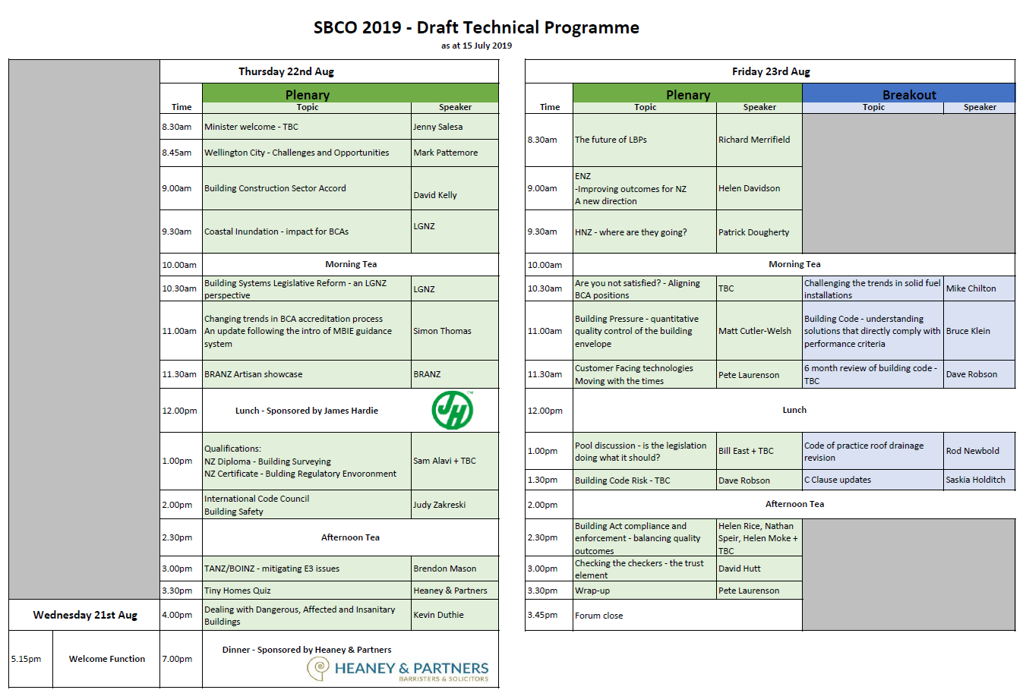
SBCO 2019
What’s on at SBCO 2019

Slide 26
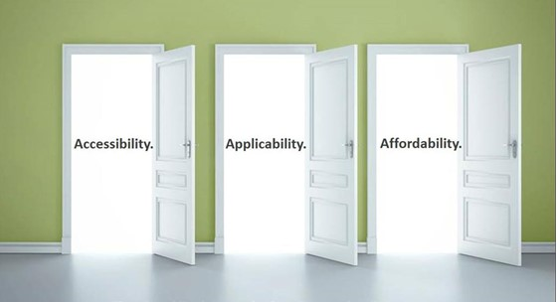
Training Update
A Journey from Education to Competence
and Advanced Training Programmes

Slide 27
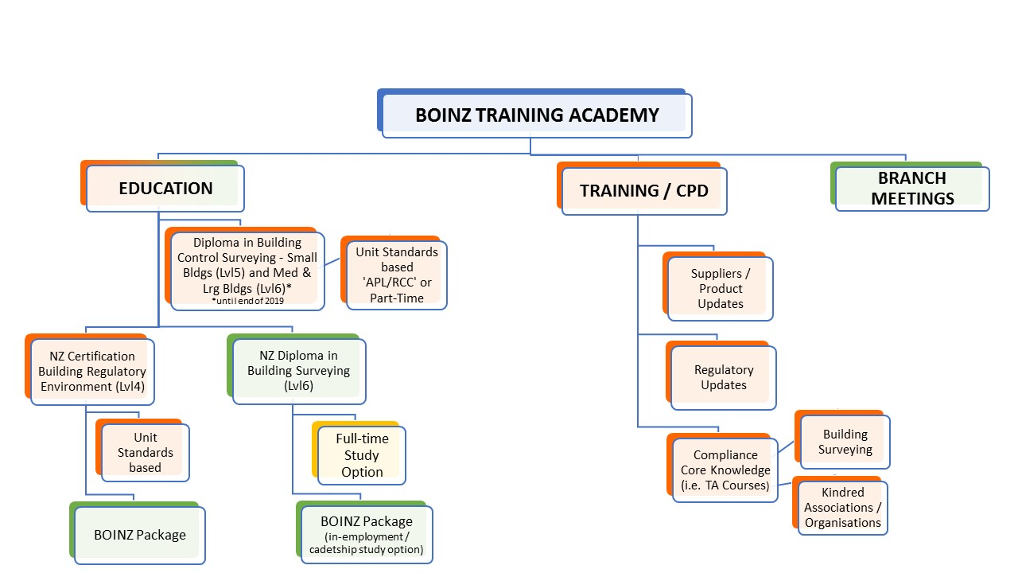

Education and Training Delivery Strategy
ADVANCED TRAINING/CPD
Specialist Guest Speakers
Last Students through this old pathway 2019

Slide 28

Training Doorways
Accessibility
Training E-News
New easy to read format
Topical
More Structured
“On-line Training Academy”
Will be launched with our new Pools course
Pre-reading
Presentation
Assessment
Further resources for post course assistance
Delivery Channels - These course will combine a mix of F2F, Online, Webinar, and Online Assessment
Online
Hybrid – A mix of F2F/Online
F2F – Where a group think is important and technical issues need leadership
Typically CPD Courses will be 1-2 hrs and Advanced Courses half a day to a day and depending on complexity will be presented in one or all formats
All online

Slide 29


Training Doorways
Applicability
NZ Diploma in Building Surveying
Meets Regulation 18 and focus’s on Building Surveying
A pipeline for industry recruitment, qualification and consistency
Currently 77 students in study for their qualification through the in – employment pathway
2 more cohorts possible in second half of 2019
Need to educate BCA’s in respect of direct value to sector compared to gaps with other qualifications
NZ Certificate in Building Regulatory Environment (Level 4) 6-8 months
A gateway of knowledge for BCA staff, Built Environment staff and school leavers looking at BCA careers

Slide 30

Training Doorways
Applicability
Advanced Courses
Added value once you have your qualification and/or a competency pathway
This range of higher-level training programmes are conducted in workshop/thinking/problem solving environments to challenge your thinking.
Beyond Acceptable Solutions (a more engaging vs theory based learning process – this is what your managers have told us they want in terms of skill enhancement
Product learning
2 Pathways
Online
Branch Training & Networking
Desired Learning Outcomes
General knowledge & trend indicator uptake
Applicability
Risk Awareness

Slide 31


Training Doorways
Applicability
Competency Training Support
On the drawing board / Big Job!!
Consulted with and supported by majority of BCA managers
The end products will deliver consistent programmes nationally to the NCAS competency levels R1 – C3
Capable of “moving programmes” with technology and legislation
Delivery channels will be Online/Hybrid/F2F
Development will be in conjunction with BCA’s and core experts, and meet Performance Indicators for each level
Learning Management System?

Slide 32


Training Doorways
Affordability
We are vested in quality outcomes for our members
Firstly, we are not training “cowboys”– if you want to be a cowboy go train somewhere else
We will be using technology for accessibility and cost control
We will compete – BUT won’t compromise of quality
We will minimise travel and accommodation where we can
Courses may be modularised to minimise work interruption
Pre-reading assessment will aid and fortify general knowledge before the course

Slide 33

Training Update (Cont….)
Advanced Courses You can apply for now
Coming Up
- Tiling / E3*
- Advanced Accessibility*
-Complying with Building Code
- BWoF
- Documenting Decisions
- Report Writing
- 100 Q&A Assessment to
identify Skill Gaps
Difficult to Consent
Advanced Fire
Earthquake Engineering
ANARP
Asbestos*
Restricting Access to Swimming Pools
Leadership Certificates
Emerging
Advanced
4 x ½ session each
via Online Training
* In development

Slide 34
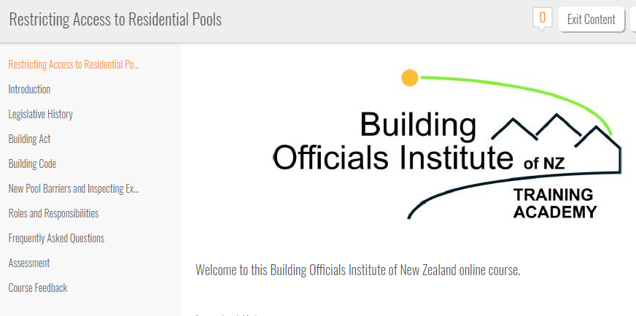
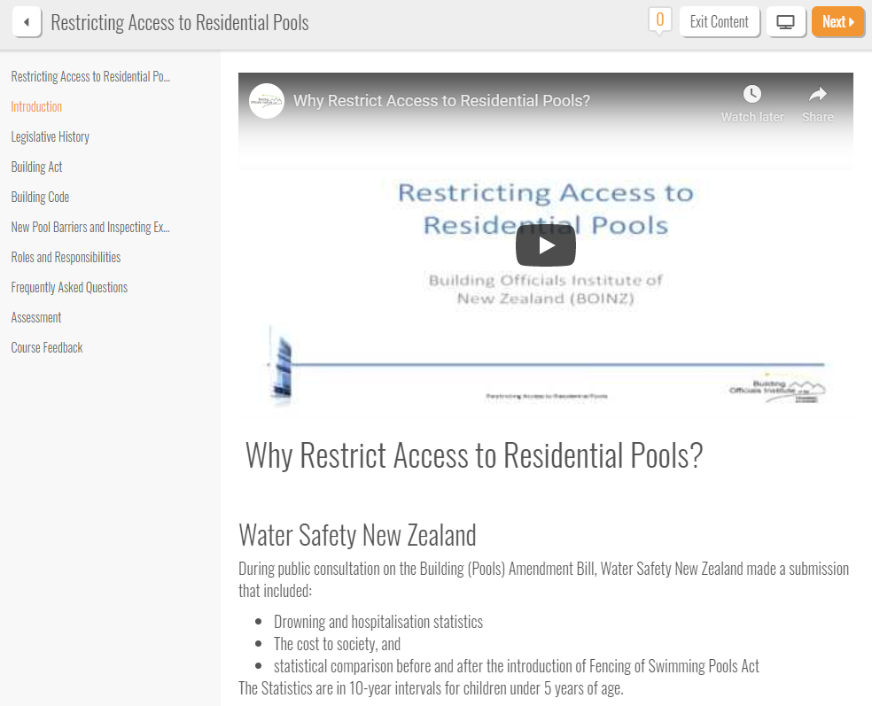
Online Training Academy
Restricting Access to Residential Pools
Ergonomic website design
Table of contents
Clickable hyperlinks for modules
Multiple learning methods targeted:
Embedded videos
Modules
Assessments

Slide 35
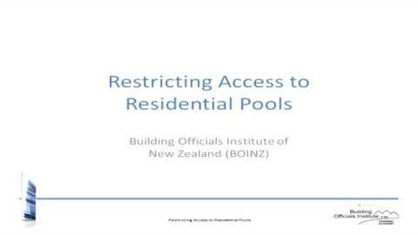
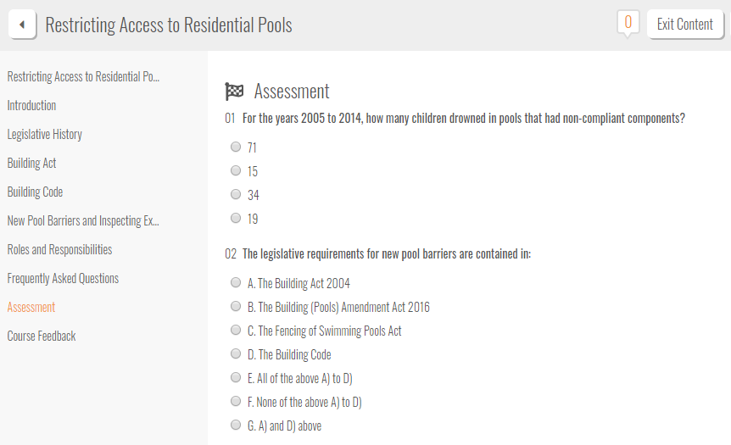
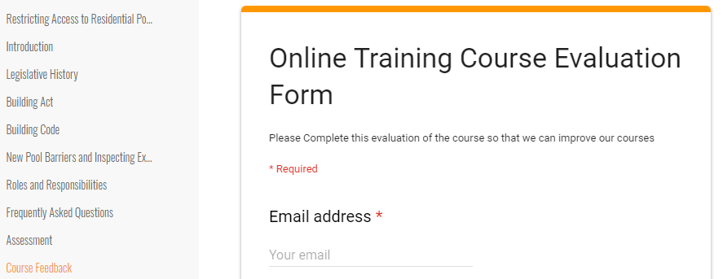
Restricting Access to Residential Pools
Video material
Assessment
Feedback and data collection

Slide 36
Advocacy
Product Assurance (Product Certification/Querying CodeMark)
Occupational Regulation (LBP Category Tiers / Site Supervision)
Risk and Liability (Capping BCA Exposure/Residential Guarantees and Insurance)
Building Levy Use / Expansion
Building System Legislative Reforms
Construction Sector Accord
Various NZ Standards
Vocational Educational Review (Monitoring)
Media / Providing Industry Opinion

Slide 37

Building Legislative Reform
BOINZ Submission sent – 14 June 2019
Member access to view submission via MYBOINZ
www.boinz.org.nz/Site/my-boinz/
Key areas of focus
Roles and Responsibilities
Information accessibility
Accountability for Quality of work
5 Reform Packages
Depends on Cabinet approval
Linked to MBIE’s “4 P’s”
Building Products
Occupational Regulation
Risk and Liability
Building Levy
Offences, penalties
Approximately 500 Submissions sent

Slide 38
Building Legislative Reform
Building Product - Focus
Fit for Purpose *
Roles and Responsibility clarification → Products and Manufacturers **
Building Product Information ***
Investigative Powers ****
What BOINZ want to see and have asked for; -
* - Better clarity for definitions around products and systems (including Prefab roles & responsibilities)
** - Include requirements for product substitution
- Designer and builder compliance with building code
*** - Require all manufacturers & suppliers (including importers to provide appropriate information) –
they will need guidance for “standard” information supply
- Mandatory Independent 3rd Party Certification for critical product in critical building areas of structure,
cladding, fire, health
**** - A significant increase in funding to force product compliance via MBIE

Slide 39
Building Legislative Reform
Occupational Legislative Reform
About protecting public from hard by regulating who can carry out certain types of work competently
3 Areas of focus
LBP’s*
Plumbers, Gasfitters & Drainlayers**
Engineers***
What we want to see and have asked for; -
* - Raise the entry level to become a LBP
- Introduce a tiered licensing system for LBP’s to progress to specific supervision and site
license (see Build Issues Aug/Sept 2018)
- Limit site license – span of control (full review needed)
** - Review and limit householder exemptions for sanitary plumbing
*** - Restrict Engineers who can carry out structural, Geotech and fire safety engineering in
complex buildings

Slide 40
Building Legislative Reform
Risk and Liability
The Law needs to change to rebalance Risk and Liability so outcomes are fairer in law and contract when things go wrong
What we want to see and have asked for; -
A mandatory warranty/insurance product for all residential builds and alternations, with no opt out
A limit on BCA liability to reduce risk adverse behavior and financial burden on ratepayers
Laws around re-phoenixing
Reduce owner responsibility – they are employing professionals so let the professionals take the risk
Building Levy
MBIE have advised they are going to reduce the rate of the Building Levy
We do not agree, if at the same time they propose to widen the powers on how the levy fund can be spent.
The build sector urgently needs financial support to produce better regulatory and operational outcomes
such as investigative function, training support.

Slide 41








Thank You

Slide 42
Recap from April Branch Meeting
BOINZ – 5 Years in 5 Minutes
Constitution Review
Vocational Education Reforms

Slide 43
BOINZ
5 Years in 5 Minutes
2013 = 4 staff
2015 Restructure
2018 = 8 staff
Turn Over
Skill Shortages
Increasing Costs
2015 Renew Lease
Lease expires Oct 2023
2015/16 Office Expansion & Refurb
STAFF
BUILDING
Accountant Change
Deloitte Private 2017 (Appt)
MYOB Online 2018
iPayroll 2018
FINANCE
OFFICE ADMIN
MoST CRM 2013-14
Dept. Processes & Procedures
Health & Safety Policies
Credit Card Policy (Updated)
Constitution Review (In progress)
Policy Review (Next)
Education/Training
HR Division
Accreditation
Technical
Diploma (Pathways x2)
(2017/18)
Certificate (nearly there)
On Line Training Academy
Intuto
CPD Program
Advanced Course Expansion
Relationship Development
Collaboration
NZHHA
PrefabNZ
MiTek
Etc.
Est. Division 2016/17
Legal
Promotion
Marketing
Expo’s
Int’l recruitment
3 x Placements
In the wings
5 x ICC
3 x FNDC
Course formulated 2015
1st Course 2015
Branding
Audit Committee
Workshops
Newsletters
Relationships
Law Society
REA
Insurance Council
Crombie Lockwood
Lower premiums
Advisory Groups
Fire
Durability/External Moisture
Plumbing & Drainage
Structure
Etc.
Standards NZ Representative
MBIE
Submissions
Consultation
Advice
Lobbying

Slide 44


BOINZ
5 Years in 5 Minutes
Membership
Advocacy
Relationships
Growth in Members
2014 → 2018
1100 → 1250
Decrease in #’s
Wellington CC
Christchurch CC
Auckland CC
Loyalty Discount Programme
2013 Introduced
EQ Responses
Occupational Regulation
Product Assurance
Risk & Liability
Premier Partners
2014 → 2018
4 → 10
Government
MBIE
ECCA
DIA
LGNZ
Ministers
Strategic
NZHHA (Secretariat)
PrefabNZ
CIC
International
AIBS
ICC
ACRS
CABE/ATTMA
Commercial
GIB
PRYDA
MiTEK
Carter Holt Harvey
Hilti
Viridian Glass
BRANZ
Pacific Steel
Resene
Ryan Fire
EBOSS
Etc.
Marketing
Straight Up
Website
2013/14
50th Year
Social Media
Facebook
Monthly Updates - 2015
E-news – 2014
Membership Surveys - 2014
Branches
9 Branches
No geographic change
Chairs & Sec Forum Continues
Branch Guidelines
Updated Annually
Guest Speakers Support
Branch Support Fund

Slide 45

Core Membership Messaging
Professionalism
(Is our core message)
Business Plan
By Year
Ongoing
Training
Consistency
Competency
Quality
Annual Reports

Slide 46

Constitution Review
A serious piece of beneficial work for the Institute
Incorporated Societies Act 1908
Under review for the 1st time in 100yrs (2013 – 2016)
Expected Changes
Basic duties for offices/committee members – akin to Board of Directors
Increased focus on managing conflicts of interest
Dispute process to be built into Constitution
Must have a Constitution, not just rules

Slide 47

Constitution Review
BOINZ - Key change recommendations to date – “sensible stuff”
Changes to Name and Definition to allow for Official and Trading names plus an ability to change our name
Rename the “Membership” section to “Structure” and define Board, Advisory Groups, Committees, Branches and Membership and include items in respect of ;-
Eligibility; Admission / Expulsion, Removal and Resignation; Cessation
A discipline process;
Entrance Fee and Subscription;
Payment to members (disclosure), Donations
Introduce a new Director election process, Triennial Rotation to ensure Board sustainability (2 per annum)
Create a 2 tier best practice Governance model – Constitution & Board Policies

Slide 48

Vocational Education Reforms
Vocational Education = Non University
= Level 3 – 6
= Excludes language
= Polytechs/PTE’s
Why government wants change
Wants an education system fit for purpose for the future
Rid the system of long standing issues
Regional issues (poor access)
Deliver to employers and learners
Address the future of work
Build on international reputation
System that is simple
Respond quickly
Quality pathway
Good network
Public education system
Save $150m/year

Slide 49

Vocational Education Reforms
Proposal
Create Industry Skills Bodies (Similar to ITO’s)
Skills leadership now for future
Setting Quals and Standards
Co-Approving Programmes
Advising TEC on Vocational Education purchasing
Work based learners would enroll with providers (not ITO’s)
Create one National Institute across all Poly’s *
Faster and greater achievements
Regional leadership groups
Consistent quality and choice of delivery
Create scale to manage enrolment fluctuations
Bolster NZ’s standing in International market
Need a new funding system
To ensure sustainable funding for providers
To support regionals, learner, employer and industry needs
Benefits to Employers
Choice of education providers to work with
Better Integration of workplace and provider based programmes
Workplace learning would be core business of vocational education providers
Day-today contact between providers and employers
Better access to skilled productive employees through nationwide programme
BOINZ position = A system that works for employers and students , not the education system

